Slide 1
Introduction

Slide 2
The Nature of Software
Software is flexible. Software is an executable specification of a computation. Software is expressive. All computable functions may be expressed in software. Complex event driven systems may be expressed in software. Software is huge. An operating system may consist of millions of lines of code. Software is complex. Software has little regularity or recognizable components found in other complex systems and there are exponentially many paths through the code and changes in one part of the code may have unintended consequences in other equally remote sections of the code. Software is cheap.

Slide 3
Manufacturing cost is zero, development cost is everything. Thus, the first copy is the engineering prototype, the production prototype and the finished product. Software is never finished. The changing requirements and ease of modification permits the maintenance phase to dominate a software product's life cycle, i.e., the maintenance phase consists of on going design and implementation cycles. Software is easily modified. It is natural to use an iterative development process combining requirements elicitation with design and implementation and use the emerging implementation to uncover errors in design and in the requirements. Software is communication. Communication with a machine but also communication between the client, the software architect, the software engineer, and the coder. Software must be readable in order to be evolvable.

Slide 4
Introduction
Getting started with software engineering

Slide 5
Objectives
To introduce software engineering and to explain its importance
To set out the answers to key questions about software engineering
To introduce ethical and professional issues and to explain why they are of concern to software engineers

Slide 6
Topics covered
FAQs about software engineering
Professional and ethical responsibility

Slide 7
Software engineering
The economies of ALL developed nations are
dependent on software
More and more systems are software controlled
Software engineering is concerned with theories, methods and tools for professional software development
Software engineering expenditure represents a
significant fraction of GNP in all developed countries

Slide 8
Software costs
Software costs often dominate system costs. The costs of software on a PC are often greater than the hardware cost
Software costs more to maintain than it does to develop. For systems with a long life, maintenance costs may be several times development costs
Software engineering is concerned with cost-effective software development

Slide 9
FAQs about software engineering
What is software?
What is software engineering?
What is the difference between software engineering and computer science?
What is the difference between software engineering and system engineering?
What is a software process?
What is a software process model?

Slide 10
FAQs about software engineering
What are the costs of software engineering?
What are software engineering methods?
What is CASE (Computer-Aided Software Engineering)
What are the attributes of good software?
What are the key challenges facing software engineering?

Slide 11
What is software?
Computer programs and associated documentation
Software products may be developed for a particular customer or may be developed for a general market
Software products may be
  Generic - developed to be sold to a range of different customers
  Bespoke (custom) - developed for a single customer according to their specification

Slide 12
What is software engineering?
Software engineering is an engineering discipline which is concerned with all aspects of software production
Software engineers should adopt a systematic and organised approach to their work and use appropriate tools and techniques depending on the problem to be solved, the development constraints and the resources available

Slide 13
What is the difference between software engineering and computer science?
Computer science is concerned with theory and fundamentals; software engineering is concerned with the practicalities of developing and delivering useful software
Computer science theories are currently insufficient to act as a complete underpinning for software engineering

Slide 14
What is the difference between software engineering and system engineering?
System engineering is concerned with all aspects of computer-based systems development including hardware, software and process engineering. Software engineering is part of this process
System engineers are involved in system specification, architectural design, integration and deployment

Slide 15
What is a software process?
A set of activities whose goal is the development or evolution of software
Generic activities in all software processes are:
  Specification - what the system should do and its development constraints
  Development - production of the software system
  Validation - checking that the software is what the customer wants
  Evolution - changing the software in response to changing demands

Slide 16
What is a software process model?
A simplified representation of a software process, presented from a specific perspective
Examples of process perspectives are
  Workflow perspective - sequence of activities
  Data-flow perspective - information flow
  Role/action perspective - who does what
Generic process models
  Waterfall
  Evolutionary development
  Formal transformation
  Integration from reusable components

Slide 17
What are the costs of software engineering?
Roughly 60% of costs are development costs, 40% are testing costs. For custom software, evolution costs often exceed development costs
Costs vary depending on the type of system being developed and the requirements of system attributes such as performance and system reliability
Distribution of costs depends on the development model that is used

Slide 18
What are software engineering methods?
Structured approaches to software development which include system models, notations, rules, design advice and process guidance
Model descriptions
  Descriptions of graphical models which should be produced
Rules
  Constraints applied to system models
Recommendations
  Advice on good design practice
Process guidance
  What activities to follow

Slide 19
What is CASE (Computer-Aided Software Engineering)
Software systems which are intended to provide automated support for software process activities. CASE systems are often used for method support
Upper-CASE
  Tools to support the early process activities of requirements and design
Lower-CASE
  Tools to support later activities such as programming, debugging and testing

Slide 20
What are the attributes of good software?
The software should deliver the required functionality and performance to the user and should be maintainable, dependable and usable
Maintainability
  Software must evolve to meet changing needs
Dependability
  Software must be trustworthy
Efficiency
  Software should not make wasteful use of system resources
Usability
  Software must be usable by the users for which it was designed

Slide 21
What are the key challenges facing software engineering?
Coping with legacy systems, coping with increasing diversity and coping with demands for reduced delivery times
Legacy systems
  Old, valuable systems must be maintained and updated
Heterogeneity
  Systems are distributed and include a mix of hardware and software
Delivery
  There is increasing pressure for faster delivery of software

Slide 22
Professional and ethical responsibility
Software engineering involves wider responsibilities than simply the application of technical skills
Software engineers must behave in an honest and ethically responsible way if they are to be respected as professionals
Ethical behaviour is more than simply upholding the law.

Slide 23
Issues of professional responsibility
Confidentiality
  Engineers should normally respect the confidentiality of their employers or clients irrespective of whether or not a formal confidentiality agreement has been signed.
Competence
  Engineers should not misrepresent their level of competence. They should not knowingly accept work which is outwith their competence.

Slide 24
Issues of professional responsibility
Intellectual property rights
  Engineers should be aware of local laws governing the use of intellectual property such as patents, copyright, etc. They should be careful to ensure that the intellectual property of employers and clients is protected.
Computer misuse
  Software engineers should not use their technical skills to misuse other people’s computers. Computer misuse ranges from relatively trivial (game playing on an employer’s machine, say) to extremely serious (dissemination of viruses).

Slide 25
ACM/IEEE Code of Ethics
The professional societies in the US have cooperated to produce a code of ethical practice.
Members of these organisations sign up to the code of practice when they join.
The Code contains eight Principles related to the behaviour of and decisions made by professional software engineers, including practitioners, educators, managers, supervisors and policy makers, as well as trainees and students of the profession.

Slide 26
Code of ethics - preamble
Preamble
  The short version of the code summarizes aspirations at a high level of the abstraction; the clauses that are included in the full version give examples and details of how these aspirations change the way we act as software engineering professionals. Without the aspirations, the details can become legalistic and tedious; without the details, the aspirations can become high sounding but empty; together, the aspirations and the details form a cohesive code.
  Software engineers shall commit themselves to making the analysis, specification, design, development, testing and maintenance of software a beneficial and respected profession. In accordance with their commitment to the health, safety and welfare of the public, software engineers shall adhere to the following Eight Principles:

Slide 27
Code of ethics - principles
1. PUBLIC
  Software engineers shall act consistently with the public interest.
2. CLIENT AND EMPLOYER
  Software engineers shall act in a manner that is in the best interests of their client and employer consistent with the public interest.
3. PRODUCT
  Software engineers shall ensure that their products and related modifications meet the highest professional standards possible.

Slide 28
Code of ethics - principles
JUDGMENT
  Software engineers shall maintain integrity and independence in their professional judgment.
5. MANAGEMENT
  Software engineering managers and leaders shall subscribe to and promote an ethical approach to the management of software development and maintenance.
6. PROFESSION
  Software engineers shall advance the integrity and reputation of the profession consistent with the public interest.

Slide 29
Code of ethics - principles
7. COLLEAGUES
  Software engineers shall be fair to and supportive of their colleagues.
8. SELF
  Software engineers shall participate in lifelong learning regarding the practice of their profession and shall promote an ethical approach to the practice of the profession.

Slide 30
Ethical dilemmas
Disagreement in principle with the policies of senior management
Your employer acts in an unethical way and releases a safety-critical system without finishing the testing of the system
Participation in the development of military weapons systems or nuclear systems

Slide 31
Key points
Software engineering is an engineering discipline which is concerned with all aspects of software production.
Software products consist of developed programs and associated documentation. Essential product attributes are maintainability, dependability, efficiency and usability.
The software process consists of activities which are involved in developing software products. Basic activities are software specification, development, validation and evolution.
Methods are organised ways of producing software. They include suggestions for the process to be followed, the notations to be used, rules governing the system descriptions which are produced and design guidelines.

Slide 32
Key points
CASE tools are software systems which are designed to support routine activities in the software process such as editing design diagrams, checking diagram consistency and keeping track of program tests which have been run.
Software engineers have responsibilities to the engineering profession and society. They should not simply be concerned with technical issues.
Professional societies publish codes of conduct which set out the standards of behaviour expected of their members.

Slide 33
Computer-Based System Engineering

Slide 34
Systems Engineering
Designing, implementing, deploying and operating systems which include hardware, software and people

Slide 35
Objectives
To explain why system software is affected by broader system engineering issues
To introduce the concept of emergent system properties such as reliability and security
To explain why the systems environment must be considered in the system design process
To explain system engineering and system procurement processes

Slide 36
Topics covered
Emergent system properties
Systems and their environment
System modelling
The system engineering process
System procurement

Slide 37
What is a system?
A purposeful collection of inter-related components working together towards some common objective.
A system may include software, mechanical, electrical and electronic hardware and be operated by people.
System components are dependent on other
system components
The properties and behaviour of system components are inextricably inter-mingled

Slide 38
Problems of systems engineering
Large systems are usually designed to solve
'wicked' problems
Systems engineering requires a great deal of
co-ordination across disciplines
  Almost infinite possibilities for design trade-offs across
  components
  Mutual distrust and lack of understanding across engineering disciplines
Systems must be designed to last many years
in a changing environment

Slide 39
Software and systems engineering
The proportion of software in systems is increasing. Software-driven general purpose electronics is replacing special-purpose systems
Problems of systems engineering are similar to
problems of software engineering
Software is (unfortunately) seen as a problem
in systems engineering. Many large system projects have been delayed because of software problems

Slide 40
Emergent properties
Properties of the system as a whole rather than properties that can be derived from the properties of components of a system
Emergent properties are a consequence of the relationships between system components
They can therefore only be assessed and measured once the components have been integrated into a system

Slide 41
Examples of emergent properties
The overall weight of the system
  This is an example of an emergent property that can be computed from individual component properties.
The reliability of the system
  This depends on the reliability of system components and the relationships between the components.
The usability of a system
  This is a complex property which is not simply dependent on the system hardware and software but also depends on the system operators and the environment where it is used.

Slide 42
Types of emergent property
Functional properties
  These appear when all the parts of a system work together to achieve some objective. For example, a bicycle has the functional property of being a transportation device once it has been assembled from its components.
Non-functional emergent properties
  Examples are reliability, performance, safety, and security. These relate to the behaviour of the system in its operational environment. They are often critical for computer-based systems as failure to achieve some minimal defined level in these properties may make the system unusable.

Slide 43
System reliability engineering
Because of component inter-dependencies,
faults can be propagated through the system
System failures often occur because of
unforeseen inter-relationships between
components
It is probably impossible to anticipate all
possible component relationships
Software reliability measures may give a false
picture of the system reliability

Slide 44
Influences on reliability
Hardware reliability
  What is the probability of a hardware component failing and how long does it take to repair that component?
Software reliability
  How likely is it that a software component will produce an incorrect output. Software failure is usually distinct from hardware failure in that software does not wear out.
Operator reliability
  How likely is it that the operator of a system will make an error?

Slide 45
Reliability relationships
Hardware failure can generate spurious signals that are outside the range of inputs expected by the software
Software errors can cause alarms to be activated which cause operator stress and lead to operator errors
The environment in which a system is installed can affect its reliability

Slide 46
The ‘shall-not’ properties
Properties such as performance and reliability can be measured
However, some properties are properties that the system should not exhibit
  Safety - the system should not behave in an unsafe way
  Security - the system should not permit unauthorised use
Measuring or assessing these properties is very hard

Slide 47
Systems and their environment
Systems are not independent but exist in an environment
System’s function may be to change its environment
Environment affects the functioning of the system e.g. system may require electrical supply from its environment
The organizational as well as the physical environment may be important

Slide 48
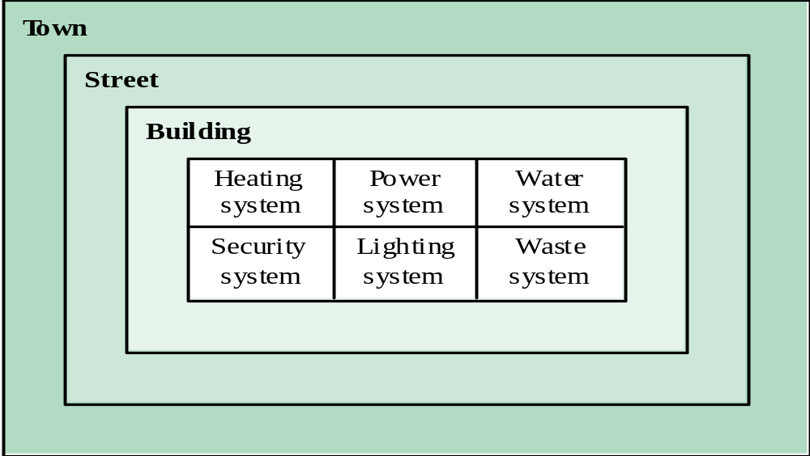
System hierarchies

Slide 49
Human and organisational factors
Process changes
  Does the system require changes to the work processes in the environment?
Job changes
  Does the system de-skill the users in an environment or cause them to change the way they work?
Organisational changes
  Does the system change the political power structure in an organisation?

Slide 50
System architecture modelling
An architectural model presents an abstract view of the sub-systems making up a system
May include major information flows between sub-systems
Usually presented as a block diagram
May identify different types of functional component in the model

Slide 51
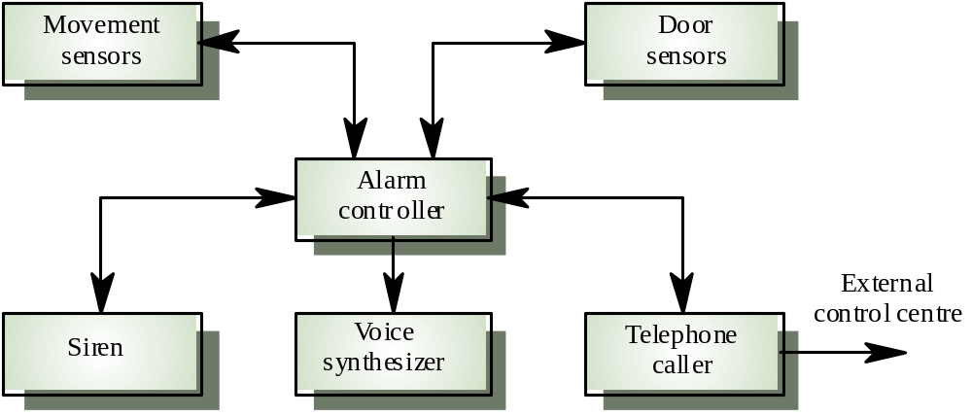
Intruder alarm system

Slide 52
Component types in alarm system
Sensor
  Movement sensor, door sensor
Actuator
  Siren
Communication
  Telephone caller
Co-ordination
  Alarm controller
Interface
  Voice synthesizer

Slide 53
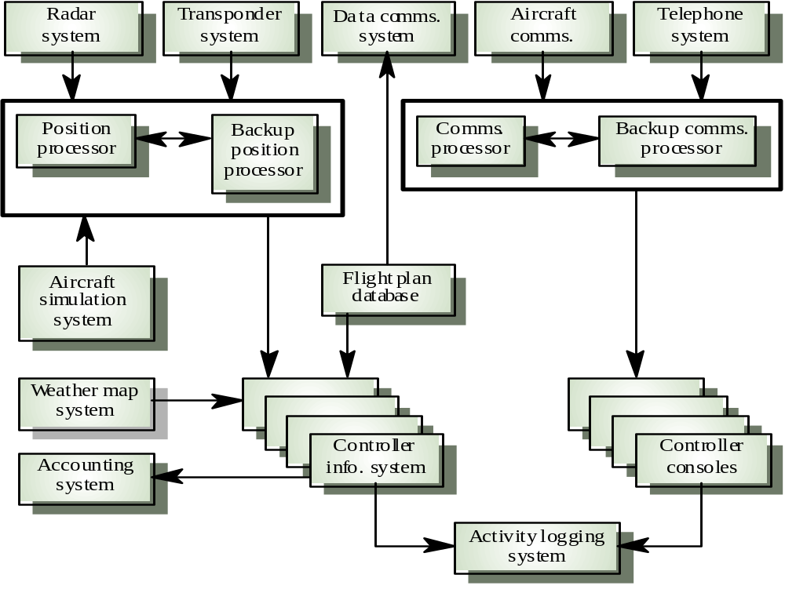
ATC system
architecture
Software Engineering

Slide 54
Functional system components
Sensor components
Actuator components
Computation components
Communication components
Co-ordination components
Interface components

Slide 55
System components
Sensor components
  Collect information from the system’s environment e.g. radars in an air traffic control system
Actuator components
  Cause some change in the system’s environment e.g. valves in a process control system which increase or decrease material flow in a pipe
Computation components
  Carry out some computations on an input to produce an output e.g. a floating point processor in a computer system

Slide 56
System components
Communication components
  Allow system components to communicate with each other e.g. network linking distributed computers
Co-ordination components
  Co-ordinate the interactions of other system components e.g. scheduler in a real-time system
Interface components
  Facilitate the interactions of other system components e.g. operator interface
All components are now usually software controlled

Slide 57
Component types in alarm system
Sensor
  Movement sensor, Door sensor
Actuator
  Siren
Communication
  Telephone caller
Coordination
  Alarm controller
Interface
  Voice synthesizer

Slide 58
The system engineering process
Usually follows a ‘waterfall’ model because of the need for parallel development of different parts of the system
  Little scope for iteration between phases because hardware changes are very expensive. Software may have to compensate for hardware problems
Inevitably involves engineers from different disciplines who must work together
  Much scope for misunderstanding here. Different disciplines use a different vocabulary and much negotiation is required. Engineers may have personal agendas to fulfil

Slide 59
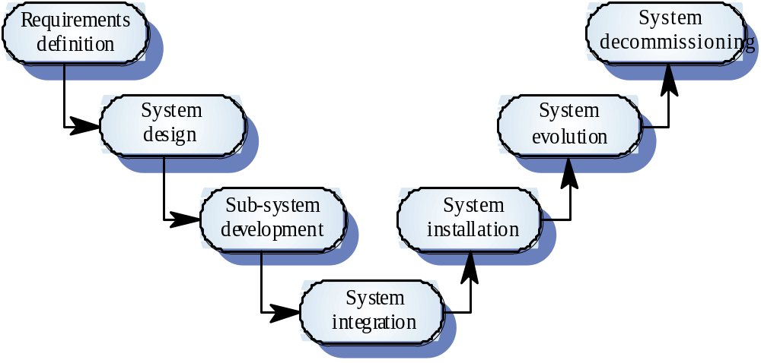
The system engineering process

Slide 60
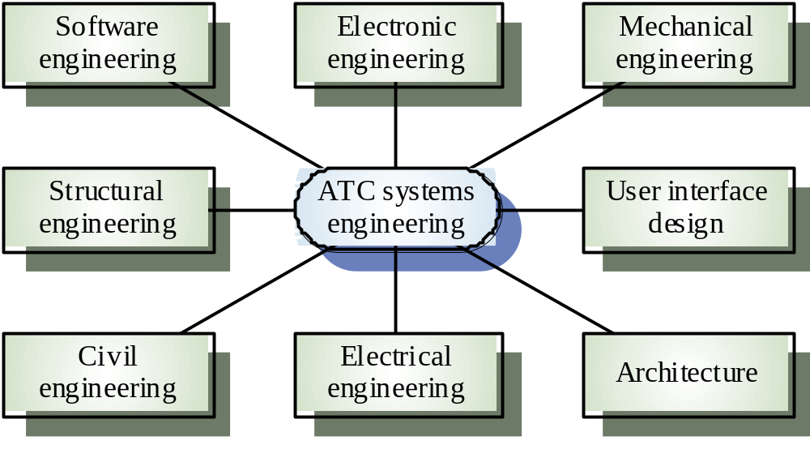
Inter-disciplinary involvement

Slide 61
System requirements definition
Three types of requirement defined at this stage
  Abstract functional requirements. System functions are defined in an abstract way
  System properties. Non-functional requirements for the system in general are defined
  Undesirable characteristics. Unacceptable system behaviour is specified
Should also define overall organisational objectives for the system

Slide 62
System objectives
Functional objectives
  To provide a fire and intruder alarm system for the building which will provide internal and external warning of fire or unauthorized intrusion
Organisational objectives
  To ensure that the normal functioning of work carried out in the building is not seriously disrupted by events such as fire and unauthorized intrusion

Slide 63
System requirements problems
Changing as the system is being specified
Must anticipate hardware/communications
developments over the lifetime of the system
Hard to define non-functional requirements
(particularly) without an impression of
component structure of the system.

Slide 64
The system design process
Partition requirements
  Organise requirements into related groups
Identify sub-systems
  Identify a set of sub-systems which collectively can meet the system requirements
Assign requirements to sub-systems
  Causes particular problems when COTS are integrated
Specify sub-system functionality
Define sub-system interfaces
  Critical activity for parallel sub-system development

Slide 65
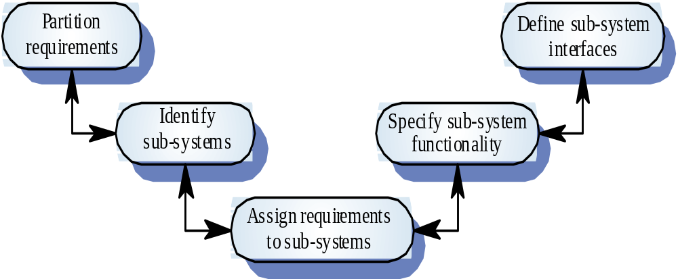
The system design process

Slide 66
System design problems
Requirements partitioning to hardware,
software and human components may involve a lot of negotiation
Difficult design problems are often assumed to be readily solved using software
Hardware platforms may be inappropriate for
software requirements so software must compensate for this

Slide 67
Sub-system development
Typically parallel projects developing the
hardware, software and communications
May involve some COTS (Commercial Off-the-Shelf) systems procurement
Lack of communication across implementation
teams
Bureaucratic and slow mechanism for
proposing system changes means that the development schedule may be extended because of the need for rework

Slide 68
System integration
The process of putting hardware, software and
people together to make a system
Should be tackled incrementally so that sub-systems are integrated one at a time
Interface problems between sub-systems are usually found at this stage
May be problems with uncoordinated deliveries
of system components

Slide 69
System installation
Environmental assumptions may be incorrect
May be human resistance to the introduction of
a new system
System may have to coexist with alternative
systems for some time
May be physical installation problems (e.g.
cabling problems)
Operator training has to be identified

Slide 70
System operation
Will bring unforeseen requirements to light
Users may use the system in a way which is
not anticipated by system designers
May reveal problems in the interaction with
other systems
  Physical problems of incompatibility
  Data conversion problems
  Increased operator error rate because of inconsistent interfaces

Slide 71
System evolution
Large systems have a long lifetime. They must evolve to meet changing requirements
Evolution is inherently costly
  Changes must be analysed from a technical and business perspective
  Sub-systems interact so unanticipated problems can arise
  There is rarely a rationale for original design decisions
  System structure is corrupted as changes are made to it
Existing systems which must be maintained are sometimes called legacy systems

Slide 72
System decommissioning
Taking the system out of service after its useful lifetime
May require removal of materials (e.g. dangerous chemicals) which pollute the environment
  Should be planned for in the system design by encapsulation
May require data to be restructured and converted to be used in some other system

Slide 73
System procurement
Acquiring a system for an organization to meet some need
Some system specification and architectural design is usually necessary before procurement
  You need a specification to let a contract for system development
  The specification may allow you to buy a commercial off-the-shelf (COTS) system. Almost always cheaper than developing a system from scratch

Slide 74
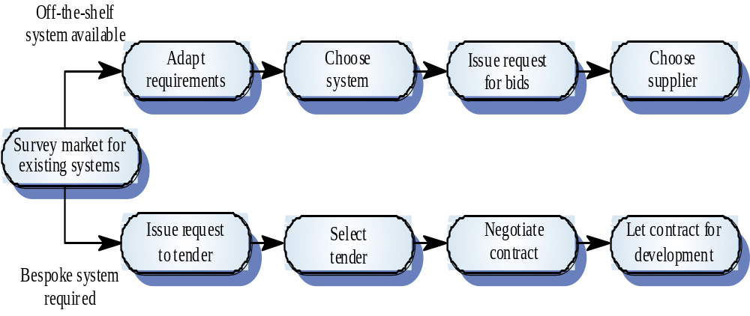
The system procurement process

Slide 75
Procurement issues
Requirements may have to be modified to match the capabilities of off-the-shelf components
The requirements specification may be part of the contract for the development of the system
There is usually a contract negotiation period to agree changes after the contractor to build a system has been selected

Slide 76
Contractors and sub-contractors
The procurement of large hardware/software systems is usually based around some principal contractor
Sub-contracts are issued to other suppliers to supply parts of the system
Customer liases with the principal contractor and does not deal directly with sub-contractors

Slide 77
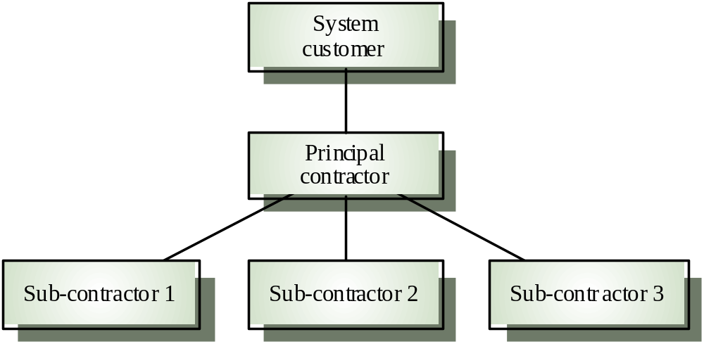
Contractor/Sub-contractor model

Slide 78
Key points
System engineering involves input from a range of disciplines
Emergent properties are properties that are characteristic of the system as a whole and not its component parts
System architectural models show major sub-systems and inter-connections. They are usually described using block diagrams

Slide 79
Key points
System component types are sensor, actuator, computation, co-ordination, communication and interface
The systems engineering process is usually a waterfall model and includes specification, design, development and integration.
System procurement is concerned with deciding which system to buy and who to buy it from

Slide 80
Conclusion
Systems engineering is hard! There will never be an easy answer to the problems of complex system development
Software engineers do not have all the answers
but may be better at taking a systems
viewpoint
Disciplines need to recognise each others
strengths and actively rather than reluctantly
cooperate in the systems engineering process

Slide 81
Software Processes

Slide 82
Software Processes
Coherent sets of activities for specifying, designing, implementing and testing software systems

Slide 83
Objectives
To introduce software process models
To describe a number of different process models and when they may be used
To describe outline process models for requirements engineering, software development, testing and evolution
To introduce CASE technology to support software process activities

Slide 84
Topics covered
Software process models
Process iteration
Software specification
Software design and implementation
Software validation
Software evolution
Automated process support

Slide 85
The software process
A structured set of activities required to develop a
software system
  Specification
  Design
  Validation
  Evolution
A software process model is an abstract representation of a process. It presents a description of a process from some particular perspective

Slide 86
Generic software process models
The waterfall model
  Separate and distinct phases of specification and development
Evolutionary development
  Specification and development are interleaved
Formal systems development
  A mathematical system model is formally transformed to an implementation
Reuse-based development
  The system is assembled from existing components

Slide 87
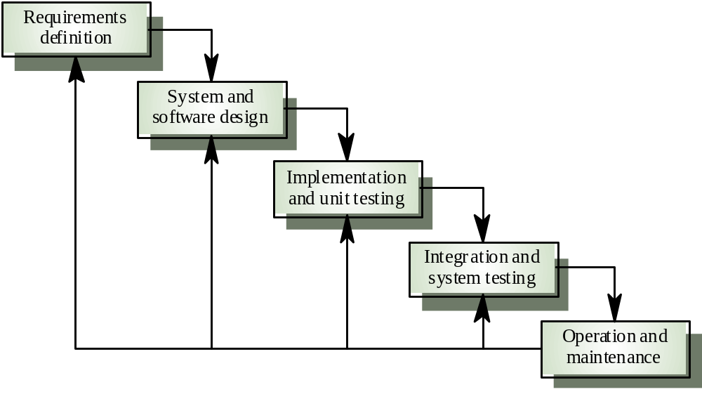
Waterfall model

Slide 88
Waterfall model phases
Requirements analysis and definition
System and software design
Implementation and unit testing
Integration and system testing
Operation and maintenance
The drawback of the waterfall model is the difficulty of accommodating change after the process is underway

Slide 89
Waterfall model problems
Inflexible partitioning of the project into distinct stages
This makes it difficult to respond to changing customer requirements
Therefore, this model is only appropriate when the requirements are well-understood

Slide 90
Evolutionary development
Exploratory development
  Objective is to work with customers and to evolve a final system from an initial outline specification. Should start with well-understood requirements
Throw-away prototyping
  Objective is to understand the system requirements. Should start with poorly understood requirements

Slide 91
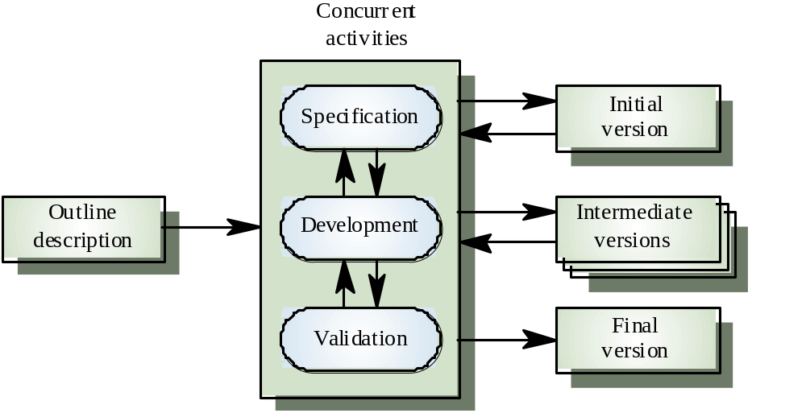
Evolutionary development

Slide 92
Evolutionary development
Problems
  Lack of process visibility
  Systems are often poorly structured
  Special skills (e.g. in languages for rapid prototyping) may be required
Applicability
  For small or medium-size interactive systems
  For parts of large systems (e.g. the user interface)
  For short-lifetime systems

Slide 93
Formal systems development
Based on the transformation of a mathematical specification through different representations to an executable program
Transformations are ‘correctness-preserving’ so it is straightforward to show that the program conforms to its specification
Embodied in the ‘Cleanroom’ approach to software development

Slide 94
Formal systems development

Slide 95
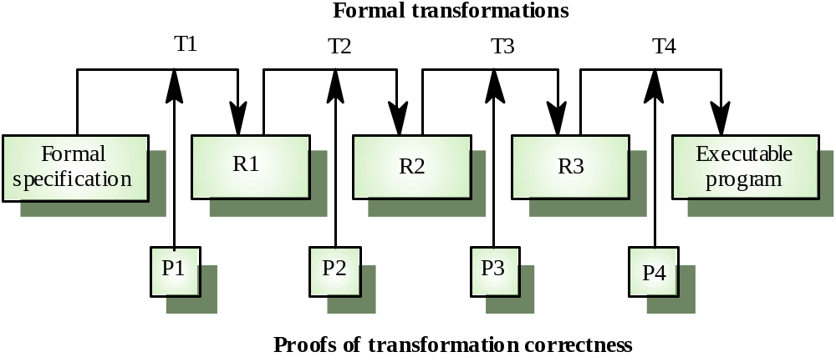
Formal transformations

Slide 96
Formal systems development
Problems
  Need for specialised skills and training to apply the technique
  Difficult to formally specify some aspects of the system such as the user interface
Applicability
  Critical systems especially those where a safety or security case must be made before the system is put into operation

Slide 97
Reuse-oriented development
Based on systematic reuse where systems are integrated from existing components or COTS (Commercial-off-the-shelf) systems
Process stages
  Component analysis
  Requirements modification
  System design with reuse
  Development and integration
This approach is becoming more important but still limited experience with it

Slide 98
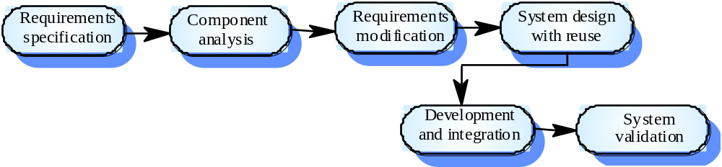
Reuse-oriented development

Slide 99
Process iteration
System requirements ALWAYS evolve in the course of a project so process iteration where earlier stages are reworked is always part of the process for large systems
Iteration can be applied to any of the generic process models
Two (related) approaches
  Incremental development
  Spiral development

Slide 100
Incremental development
Rather than deliver the system as a single delivery, the development and delivery is broken down into increments with each increment delivering part of the required functionality
User requirements are prioritised and the highest priority requirements are included in early increments
Once the development of an increment is started, the requirements are frozen though requirements for later increments can continue to evolve

Slide 101
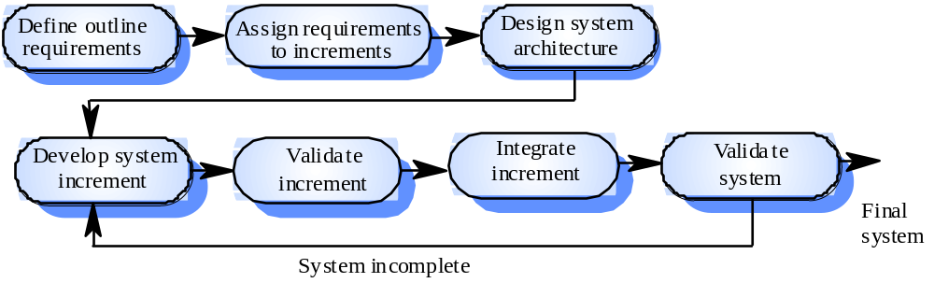
Incremental development

Slide 102
Incremental development advantages
Customer value can be delivered with each increment so system functionality is available earlier
Early increments act as a prototype to help elicit requirements for later increments
Lower risk of overall project failure
The highest priority system services tend to receive the most testing

Slide 103
Extreme programming
New approach to development based on the development and delivery of very small increments of functionality
Relies on constant code improvement, user involvement in the development team and pairwise programming

Slide 104
Spiral development
Process is represented as a spiral rather than as a sequence of activities with backtracking
Each loop in the spiral represents a phase in the process.
No fixed phases such as specification or design - loops in the spiral are chosen depending on what is required
Risks are explicitly assessed and resolved throughout the process

Slide 105
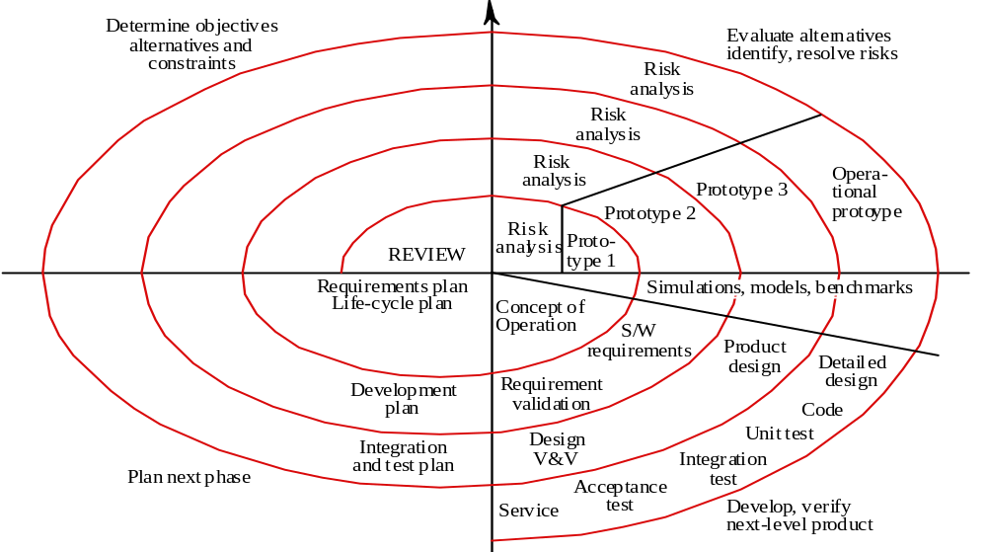
Spiral model of the software process

Slide 106
Spiral model sectors
Objective setting
  Specific objectives for the phase are identified
Risk assessment and reduction
  Risks are assessed and activities put in place to reduce the key risks
Development and validation
  A development model for the system is chosen which can be any of the generic models
Planning
  The project is reviewed and the next phase of the spiral is planned

Slide 107
Software specification
The process of establishing what services are required and the constraints on the system’s operation and development
Requirements engineering process
  Feasibility study
  Requirements elicitation and analysis
  Requirements specification
  Requirements validation

Slide 108
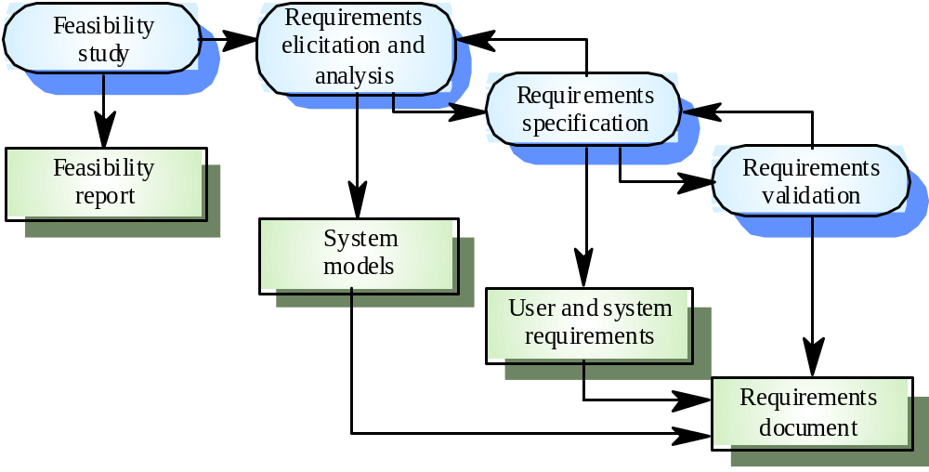
The requirements engineering process

Slide 109
Software design and implementation
The process of converting the system specification into an executable system
Software design
  Design a software structure that realises the specification
Implementation
  Translate this structure into an executable program
The activities of design and implementation are closely related and may be inter-leaved

Slide 110
Design process activities
Architectural design
Abstract specification
Interface design
Component design
Data structure design
Algorithm design

Slide 111
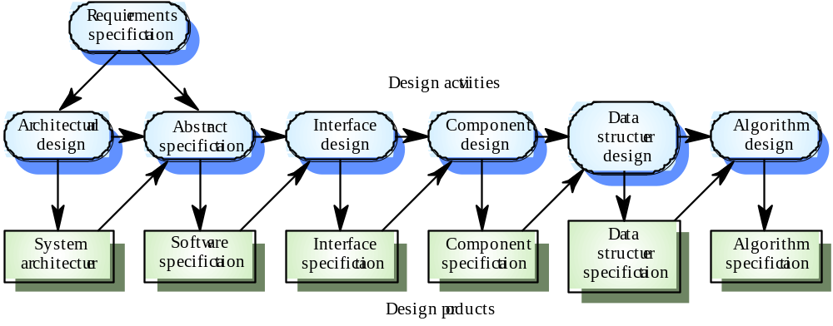
The software design process

Slide 112
Design methods
Systematic approaches to developing a software design
The design is usually documented as a set of graphical models
Possible models
  Data-flow model
  Entity-relation-attribute model
  Structural model
  Object models

Slide 113
Programming and debugging
Translating a design into a program and removing errors from that program
Programming is a personal activity - there is no generic programming process
Programmers carry out some program testing to discover faults in the program and remove these faults in the debugging process

Slide 114
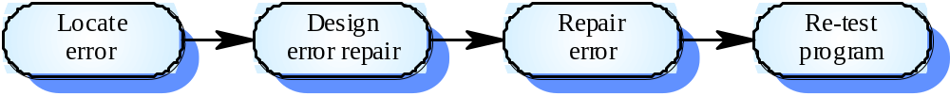
The debugging process

Slide 115
Software validation
Verification and validation is intended to show that a system conforms to its specification and meets the requirements of the system customer
Involves checking and review processes and system testing
System testing involves executing the system with test cases that are derived from the specification of the real data to be processed by the system

Slide 116
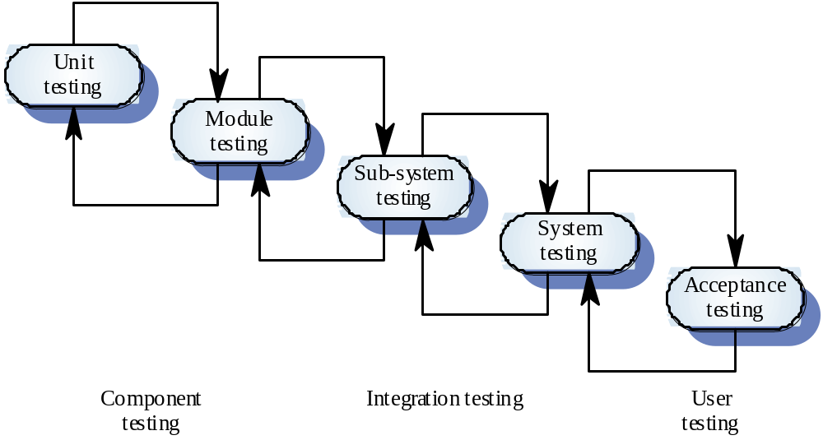
The testing process

Slide 117
Testing stages
Unit testing
  Individual components are tested
Module testing
  Related collections of dependent components are tested
Sub-system testing
  Modules are integrated into sub-systems and tested. The focus here should be on interface testing
System testing
  Testing of the system as a whole. Testing of emergent properties
Acceptance testing
  Testing with customer data to check that it is acceptable

Slide 118
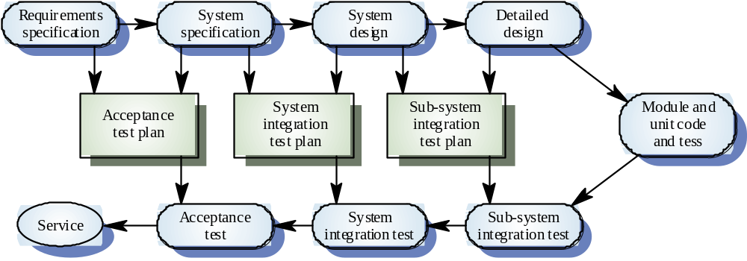
Testing phases

Slide 119
Software evolution
Software is inherently flexible and can change.
As requirements change through changing business circumstances, the software that supports the business must also evolve and change
Although there has been a demarcation between development and evolution (maintenance) this is increasingly irrelevant as fewer and fewer systems are completely new

Slide 120
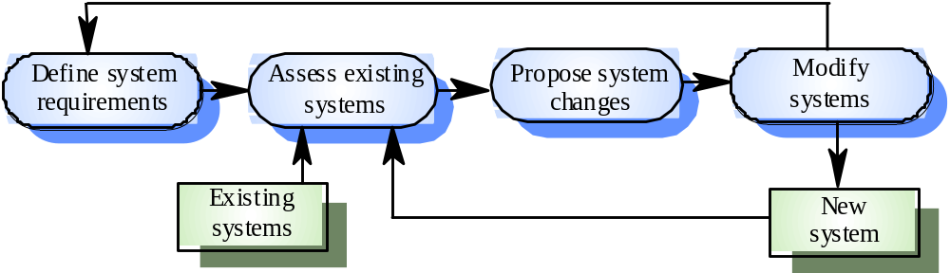
System evolution

Slide 121
Automated process support (CASE)
Computer-aided software engineering (CASE) is software to support software development and evolution processes
Activity automation
  Graphical editors for system model development
  Data dictionary to manage design entities
  Graphical UI builder for user interface construction
  Debuggers to support program fault finding
  Automated translators to generate new versions of a program

Slide 122
Case technology
Case technology has led to significant improvements in the software process though not the order of magnitude improvements that were once predicted
  Software engineering requires creative thought - this is not readily automatable
  Software engineering is a team activity and, for large projects, much time is spent in team interactions. CASE technology does not really support these

Slide 123
CASE classification
Classification helps us understand the different types of CASE tools and their support for process activities
Functional perspective
  Tools are classified according to their specific function
Process perspective
  Tools are classified according to process activities that are supported
Integration perspective
  Tools are classified according to their organisation into integrated units

Slide 124
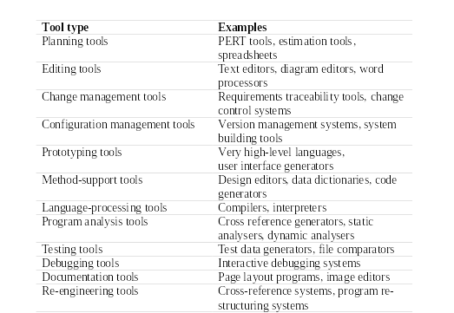
Functional tool classification

Slide 125
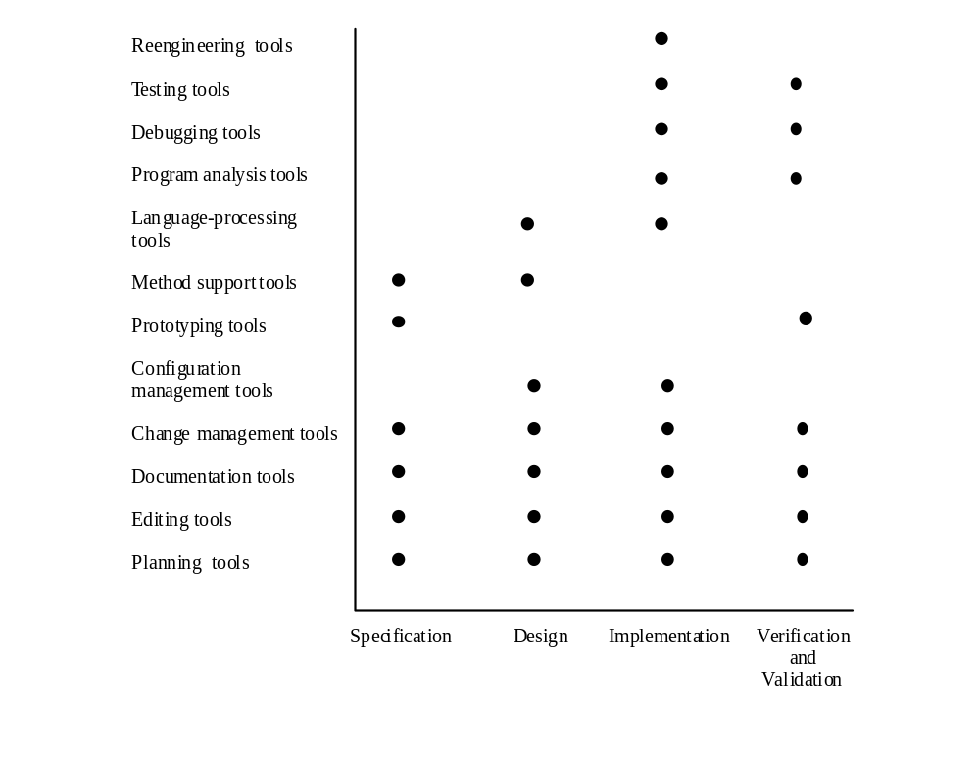
Activity-based classification

Slide 126
CASE integration
Tools
  Support individual process tasks such as design consistency checking, text editing, etc.
Workbenches
  Support a process phase such as specification or design, Normally include a number of integrated tools
Environments
  Support all or a substantial part of an entire software process. Normally include several integrated workbenches

Slide 127
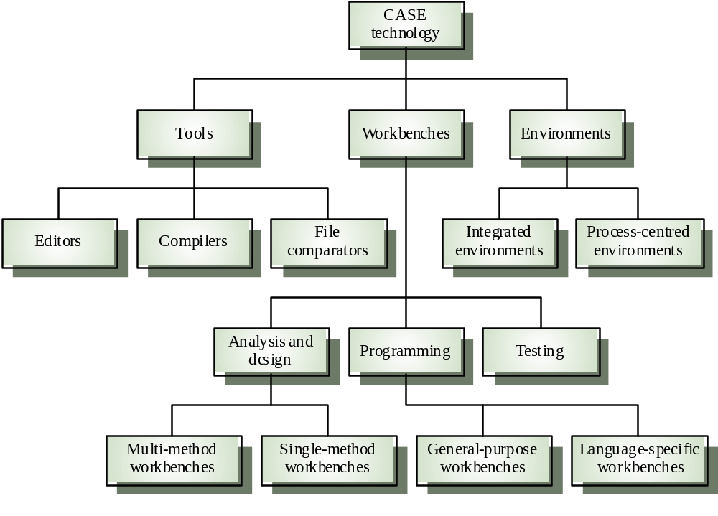
Tools, workbenches, environments

Slide 128
Key points
Software processes are the activities involved in producing and evolving a software system. They are represented in a software process model
General activities are specification, design and implementation, validation and evolution
Generic process models describe the organisation of software processes
Iterative process models describe the software process as a cycle of activities

Slide 129
Key points
Requirements engineering is the process of developing a software specification
Design and implementation processes transform the specification to an executable program
Validation involves checking that the system meets to its specification and user needs
Evolution is concerned with modifying the system after it is in use
CASE technology supports software process activities

Slide 130
Software Requirements

Slide 131
Software Requirements
Descriptions and specifications of a system

Slide 132
Objectives
To introduce the concepts of user and system requirements
To describe functional and non-functional requirements
To explain two techniques for describing system requirements
To explain how software requirements may be organised in a requirements document

Slide 133
Topics covered
Functional and non-functional requirements
User requirements
System requirements
The software requirements document

Slide 134
Requirements engineering
The process of establishing the services that the customer requires from a system and the constraints under which it operates and is developed
The requirements themselves are the descriptions of the system services and constraints that are generated during the requirements engineering process

Slide 135
What is a requirement?
It may range from a high-level abstract statement of a service or of a system constraint to a detailed mathematical functional specification
This is inevitable as requirements may serve a dual function
  May be the basis for a bid for a contract - therefore must be open to interpretation
  May be the basis for the contract itself - therefore must be defined in detail
  Both these statements may be called requirements

Slide 136
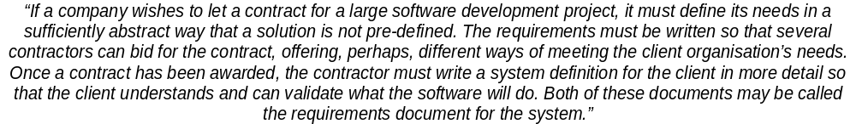
Requirements abstraction (Davis)

Slide 137
Types of requirement
User requirements
  Statements in natural language plus diagrams of the services the system provides and its operational constraints. Written for customers
System requirements
  A structured document setting out detailed descriptions of the system services. Written as a contract between client and contractor
Software specification
  A detailed software description which can serve as a basis for a design or implementation. Written for developers

Slide 138
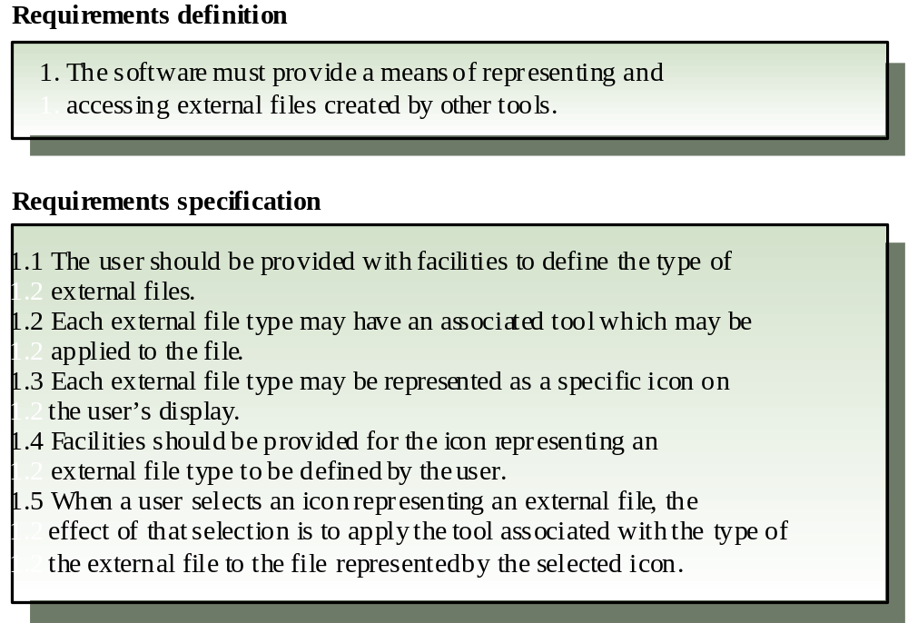
Definitions and specifications

Slide 139
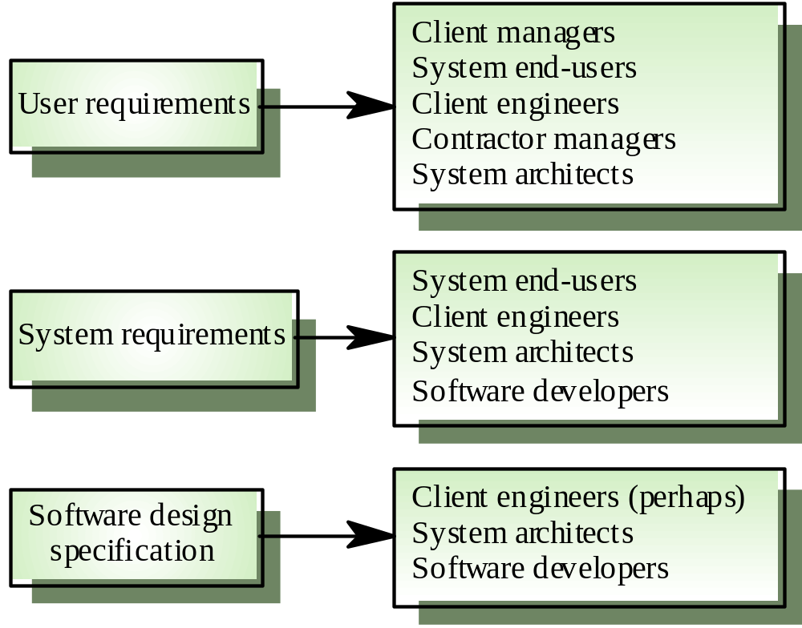
Requirements readers

Slide 140
Functional and non-functional requirements
Functional requirements
  Statements of services the system should provide, how the system should react to particular inputs and how the system should behave in particular situations.
Non-functional requirements
  constraints on the services or functions offered by the system such as timing constraints, constraints on the development process, standards, etc.
Domain requirements
  Requirements that come from the application domain of the system and that reflect characteristics of that domain

Slide 141
Functional requirements
Describe functionality or system services
Depend on the type of software, expected users and the type of system where the software is used
Functional user requirements may be high-level statements of what the system should do but functional system requirements should describe the system services in detail

Slide 142
Examples of functional requirements
The user shall be able to search either all of the initial set of databases or select a subset from it.
The system shall provide appropriate viewers for the user to read documents in the document store.
Every order shall be allocated a unique identifier (ORDER_ID) which the user shall be able to copy to the account’s permanent storage area.

Slide 143
Requirements imprecision
Problems arise when requirements are not precisely stated
Ambiguous requirements may be interpreted in different ways by developers and users
Consider the term ‘appropriate viewers’
  User intention - special purpose viewer for each different document type
  Developer interpretation - Provide a text viewer that shows the contents of the document

Slide 144
Requirements completeness and consistency
In principle requirements should be both complete and consistent
Complete
  They should include descriptions of all facilities required
Consistent
  There should be no conflicts or contradictions in the descriptions of the system facilities
In practice, it is impossible to produce a complete and consistent requirements document

Slide 145
Non-functional requirements
Define system properties and constraints e.g. reliability, response time and storage requirements. Constraints are I/O device capability, system representations, etc.
Process requirements may also be specified mandating a particular CASE system, programming language or development method
Non-functional requirements may be more critical than functional requirements. If these are not met, the system is useless

Slide 146
Non-functional classifications
Product requirements
  Requirements which specify that the delivered product must behave in a particular way e.g. execution speed, reliability, etc.
Organisational requirements
  Requirements which are a consequence of organisational policies and procedures e.g. process standards used, implementation requirements, etc.
External requirements
  Requirements which arise from factors which are external to the system and its development process e.g. interoperability requirements, legislative requirements, etc.

Slide 147
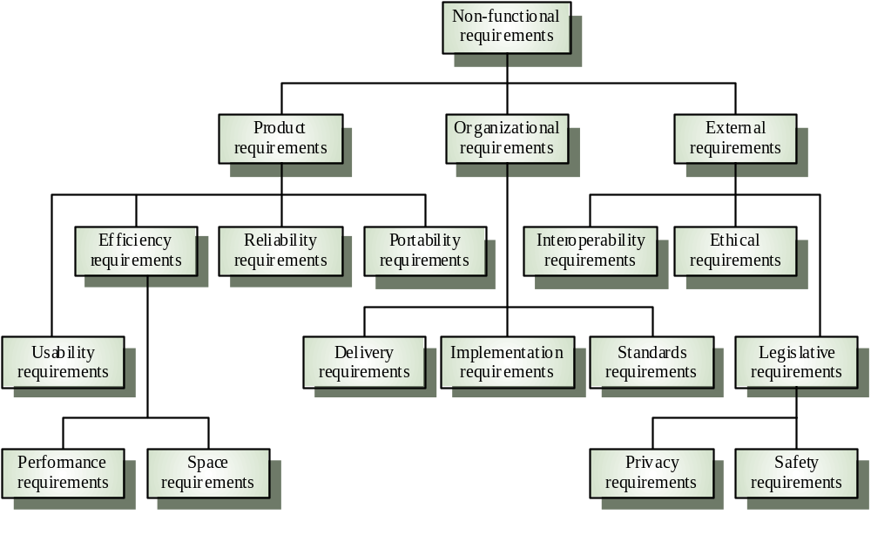
Non-functional requirement types

Slide 148
Non-functional requirements examples
Product requirement
  4.C.8 It shall be possible for all necessary communication between the APSE and the user to be expressed in the standard Ada character set
Organisational requirement
  9.3.2 The system development process and deliverable documents shall conform to the process and deliverables defined in XYZCo-SP-STAN-95
External requirement
  7.6.5 The system shall not disclose any personal information about customers apart from their name and reference number to the operators of the system

Slide 149
Goals and requirements
Non-functional requirements may be very difficult to state precisely and imprecise requirements may be difficult to verify.
Goal
  A general intention of the user such as ease of use
Verifiable non-functional requirement
  A statement using some measure that can be objectively tested
Goals are helpful to developers as they convey the intentions of the system users

Slide 150
Examples
A system goal
  The system should be easy to use by experienced controllers and should be organised in such a way that user errors are minimised.
A verifiable non-functional requirement
  Experienced controllers shall be able to use all the system functions after a total of two hours training. After this training, the average number of errors made by experienced users shall not exceed two per day.

Slide 151
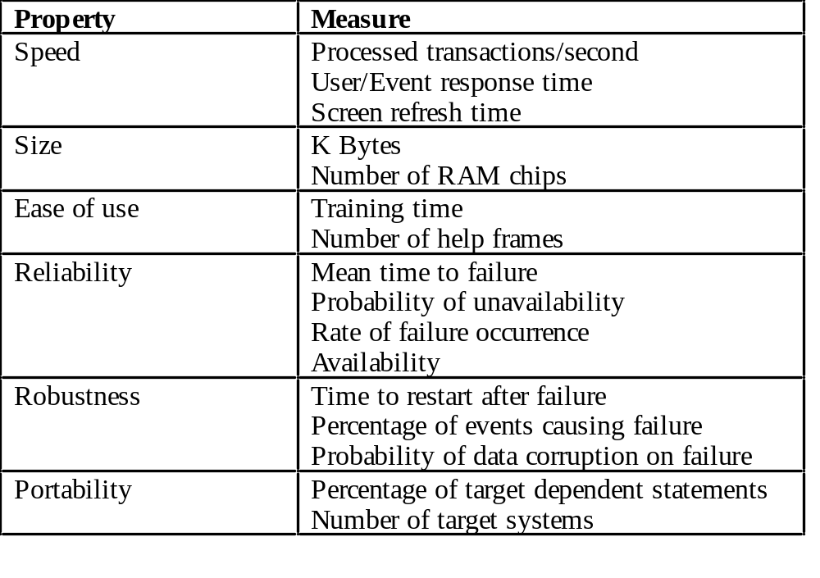
Requirements measures

Slide 152
Requirements interaction
Conflicts between different non-functional requirements are common in complex systems
Spacecraft system
  To minimise weight, the number of separate chips in the system should be minimised
  To minimise power consumption, lower power chips should be used
  However, using low power chips may mean that more chips have to be used. Which is the most critical requirement?

Slide 153
Domain requirements
Derived from the application domain and describe system characterisics and features that reflect the domain
May be new functional requirements, constraints on existing requirements or define specific computations
If domain requirements are not satisfied, the system may be unworkable

Slide 154
Library system domain requirements
There shall be a standard user interface to all databases which shall be based on the Z39.50 standard.
Because of copyright restrictions, some documents must be deleted immediately on arrival. Depending on the user’s requirements, these documents will either be printed locally on the system server for manually forwarding to the user or routed to a network printer.

Slide 155
Train protection system
The deceleration of the train shall be computed as:
  D_{train} = D_{control} + D_{gradient}
where D_{gradient} is 9.81ms² * compensated gradient/alpha and where the values of 9.81ms² /alpha are known for different types of train.

Slide 156
Domain requirements problems
Understandability
  Requirements are expressed in the language of the application domain
  This is often not understood by software engineers developing the system
Implicitness
  Domain specialists understand the area so well that they do not think of making the domain requirements explicit

Slide 157
User requirements
Should describe functional and non-functional requirements so that they are understandable by system users who don’t have detailed technical knowledge
User requirements are defined using natural language, tables and diagrams

Slide 158
Problems with natural language
Lack of clarity
  Precision is difficult without making the document difficult to read
Requirements confusion
  Functional and non-functional requirements tend to be mixed-up
Requirements amalgamation
  Several different requirements may be expressed together

Slide 159
Database requirement
4.A.5 The database shall support the generation and control of
configuration objects; that is, objects which are themselves groupings
of other objects in the database. The configuration control facilities
shall allow access to the objects in a version group by the use of an
incomplete name.

Slide 160
Editor grid requirement
2.6 Grid facilities To assist in the positioning of entities on a diagram,
the user may turn on a grid in either centimetres or inches, via an
option on the control panel. Initially, the grid is off. The grid may be
turned on and off at any time during an editing session and can be
toggled between inches and centimetres at any time. A grid option
will be provided on the reduce-to-fit view but the number of grid
lines shown will be reduced to avoid filling the smaller diagram
with grid lines.

Slide 161
Requirement problems
Database requirements includes both conceptual and detailed information
  Describes the concept of configuration control facilities
  Includes the detail that objects may be accessed using an incomplete name
Grid requirement mixes three different kinds of requirement
  Conceptual functional requirement (the need for a grid)
  Non-functional requirement (grid units)
  Non-functional UI requirement (grid switching)

Slide 162
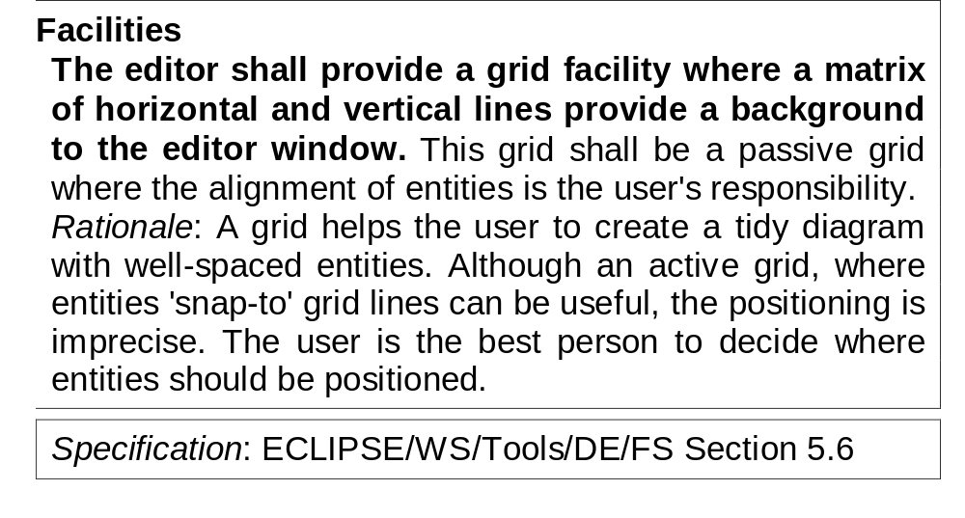
Structured presentation

Slide 163
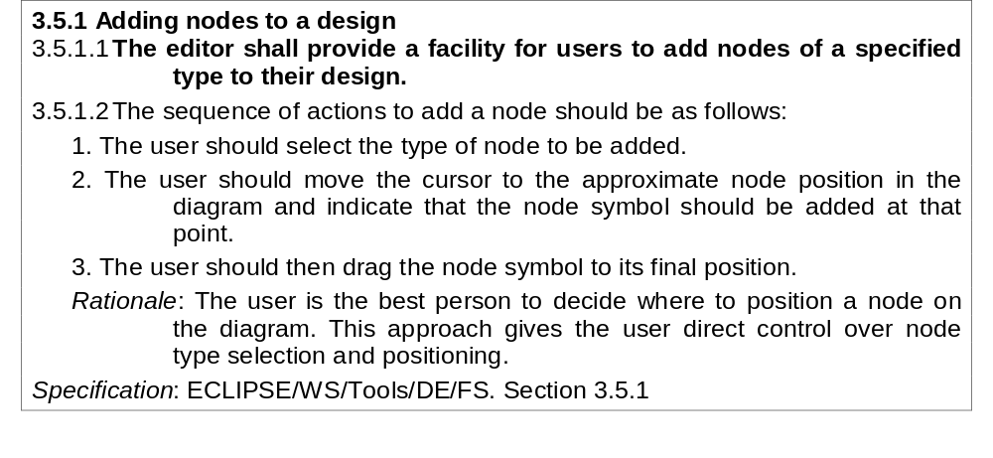
Detailed user requirement

Slide 164
Guidelines for writing requirements
Invent a standard format and use it for all requirements
Use language in a consistent way. Use shall for mandatory requirements, should for desirable requirements
Use text highlighting to identify key parts of the requirement
Avoid the use of computer jargon

Slide 165
System requirements
More detailed specifications of user requirements
Serve as a basis for designing the system
May be used as part of the system contract
System requirements may be expressed using system models discussed in Chapter 7

Slide 166
Requirements and design
In principle, requirements should state what the system should do and the design should describe how it does this
In practice, requirements and design are inseparable
  A system architecture may be designed to structure the requirements
  The system may inter-operate with other systems that generate design requirements
  The use of a specific design may be a domain requirement

Slide 167
Problems with NL specification
Ambiguity
  The readers and writers of the requirement must interpret the same words in the same way. NL is naturally ambiguous so this is very difficult
Over-flexibility
  The same thing may be said in a number of different ways in the specification
Lack of modularisation
  NL structures are inadequate to structure system requirements

Slide 168
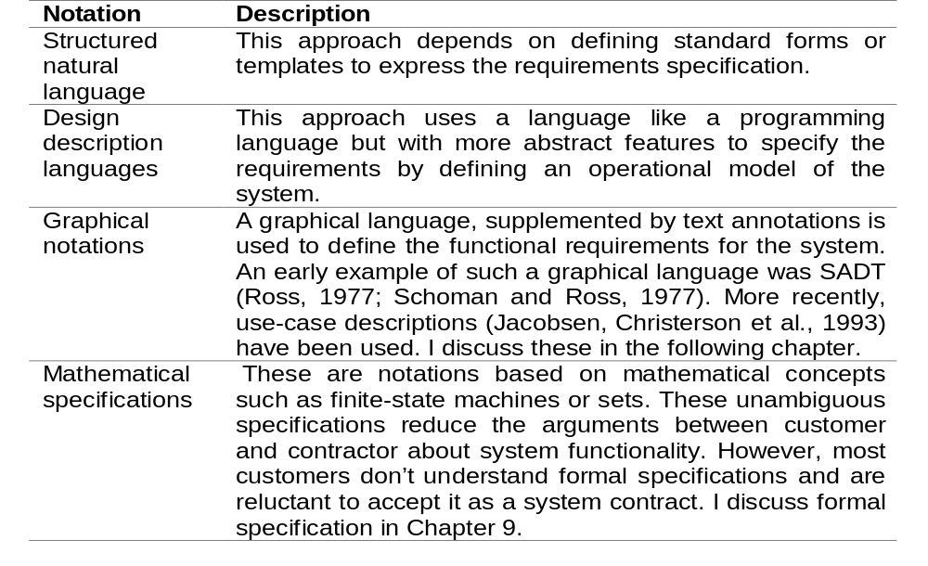
Alternatives to NL specification

Slide 169
Structured language specifications
A limited form of natural language may be used to express requirements
This removes some of the problems resulting from ambiguity and flexibility and imposes a degree of uniformity on a specification
Often bast supported using a forms-based approach

Slide 170
Form-based specifications
Definition of the function or entity
Description of inputs and where they come from
Description of outputs and where they go to
Indication of other entities required
Pre and post conditions (if appropriate)
The side effects (if any)

Slide 171
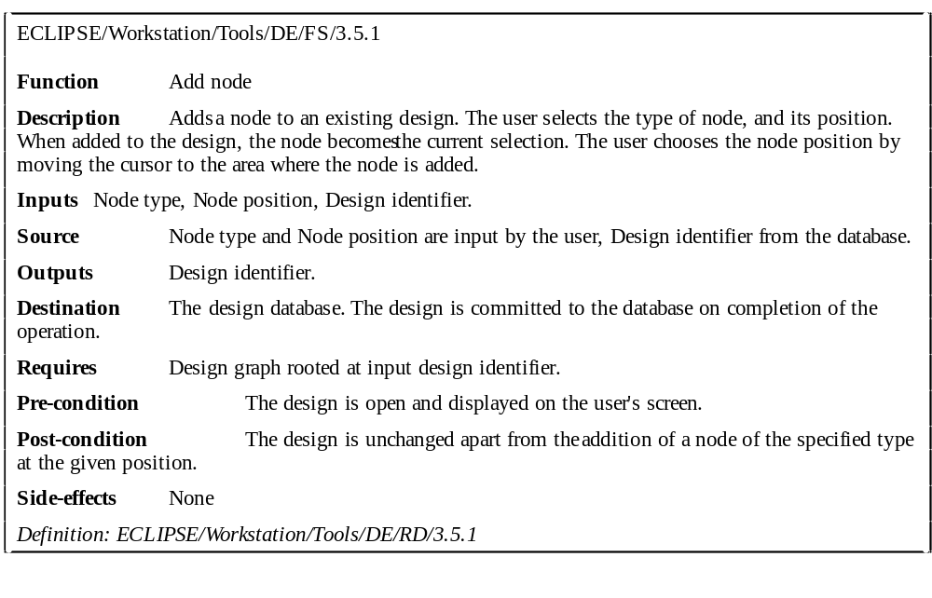
Form-based node specification

Slide 172
PDL-based requirements definition
Requirements may be defined operationally using a language like a programming language but with more flexibility of expression
Most appropriate in two situations
  Where an operation is specified as a sequence of actions and the order is important
  When hardware and software interfaces have to be specified
Disadvantages are
  The PDL may not be sufficiently expressive to define domain concepts
  The specification will be taken as a design rather than a specification

Slide 173
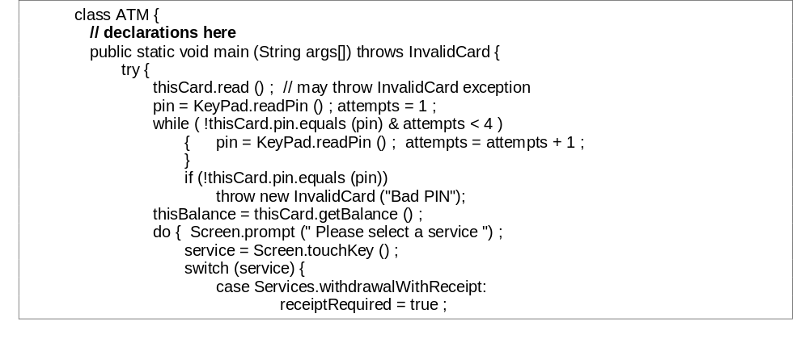
Part of an ATM specification

Slide 174
PDL disadvantages
PDL may not be sufficiently expressive to express the system functionality in an understandable way
Notation is only understandable to people with programming language knowledge
The requirement may be taken as a design specification rather than a model to help understand the system

Slide 175
Interface specification
Most systems must operate with other systems and the operating interfaces must be specified as part of the requirements
Three types of interface may have to be defined
  Procedural interfaces
  Data structures that are exchanged
  Data representations
Formal notations are an effective technique for interface specification

Slide 176
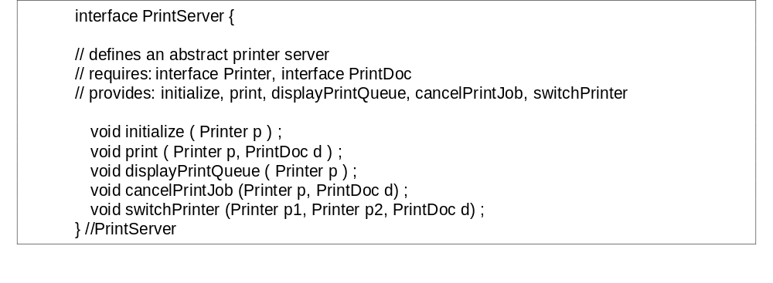
PDL interface description

Slide 177
The requirements document
The requirements document is the official statement of what is required of the system developers
Should include both a definition and a specification of requirements
It is NOT a design document. As far as possible, it should set of WHAT the system should do rather than HOW it should do it

Slide 178
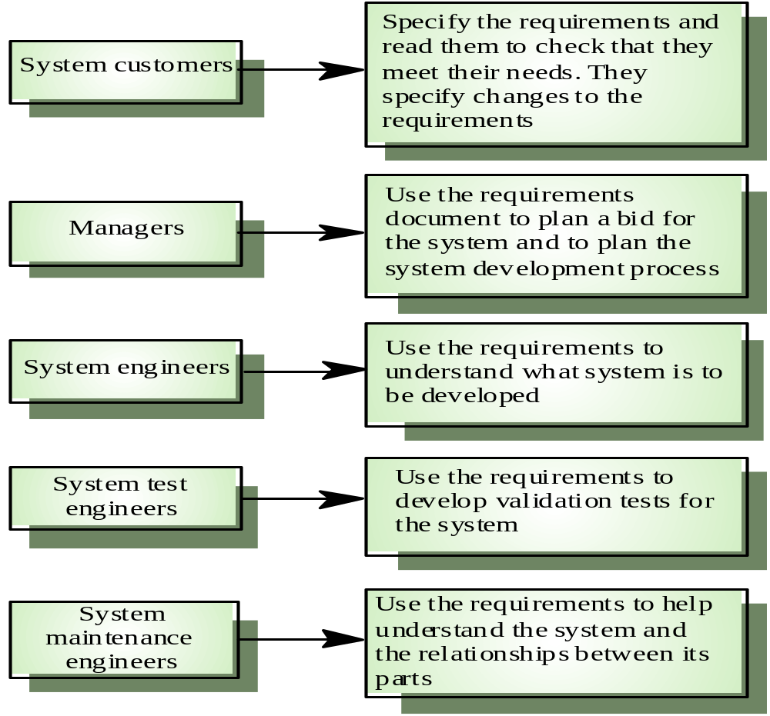
Users of a requirements document

Slide 179
Requirements document requirements
Specify external system behaviour
Specify implementation constraints
Easy to change
Serve as reference tool for maintenance
Record forethought about the life cycle of the system i.e. predict changes
Characterise responses to unexpected events

Slide 180
IEEE requirements standard
Introduction
General description
Specific requirements
Appendices
Index
This is a generic structure that must be instantiated for specific systems

Slide 181
Requirements document structure
Introduction
Glossary
User requirements definition
System architecture
System requirements specification
System models
System evolution
Appendices
Index

Slide 182
Key points
Requirements set out what the system should do and define constraints on its operation and implementation
Functional requirements set out services the system should provide
Non-functional requirements constrain the system being developed or the development process
User requirements are high-level statements of what the system should do

Slide 183
Key points
User requirements should be written in natural language, tables and diagrams
System requirements are intended to communicate the functions that the system should provide
System requirements may be written in structured natural language, a PDL or in a formal language
A software requirements document is an agreed statement of the system requirements

Slide 184
System Models

Slide 185
System models
Abstract descriptions of systems whose requirements are being analysed

Slide 186
Objectives
To explain why the context of a system should be modelled as part of the RE process
To describe behavioural modelling, data modelling and object modelling
To introduce some of the notations used in the Unified Modeling Language (UML)
To show how CASE workbenches support system modelling

Slide 187
Topics covered
Context models
Behavioural models
Data models
Object models
CASE workbenches

Slide 188
System modelling
System modelling helps the analyst to understand the functionality of the system and models are used to communicate with customers
Different models present the system from different perspectives
  External perspective showing the system’s context or environment
  Behavioural perspective showing the behaviour of the system
  Structural perspective showing the system or data architecture

Slide 189
Structured methods
Structured methods incorporate system modelling as an inherent part of the method
Methods define a set of models, a process for deriving these models and rules and guidelines that should apply to the models
CASE tools support system modelling as part of a structured method

Slide 190
Method weaknesses
They do not model non-functional system requirements
They do not usually include information about whether a method is appropriate for a given problem
The may produce too much documentation
The system models are sometimes too detailed and difficult for users to understand

Slide 191
Model types
Data processing model showing how the data is processed at different stages
Composition model showing how entities are composed of other entities
Architectural model showing principal sub-systems
Classification model showing how entities have common characteristics
Stimulus/response model showing the system’s reaction to events

Slide 192
Context models
Context models are used to illustrate the boundaries of a system
Social and organisational concerns may affect the decision on where to position system boundaries
Architectural models show the a system and its relationship with other systems

Slide 193
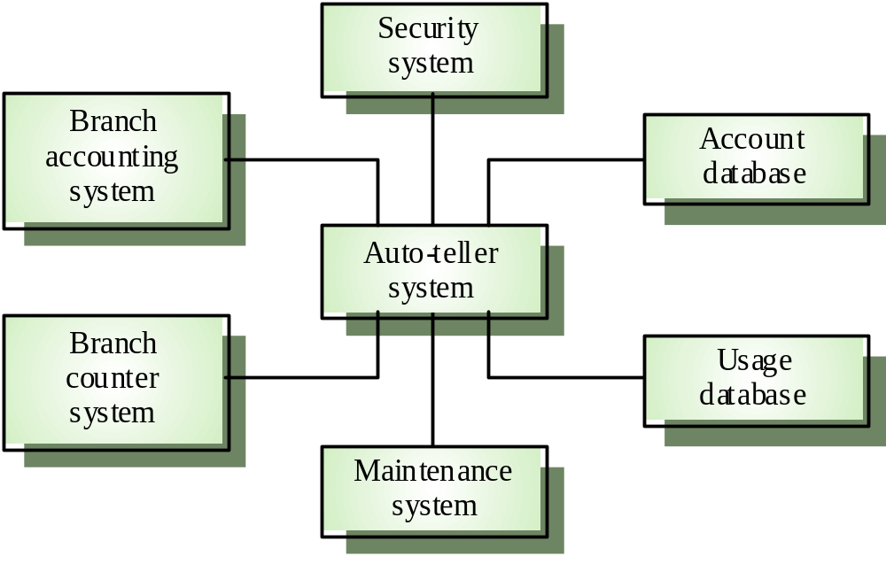
The context of an ATM system

Slide 194
Process models
Process models show the overall process and the processes that are supported by the system
Data flow models may be used to show the processes and the flow of information from one process to another

Slide 195
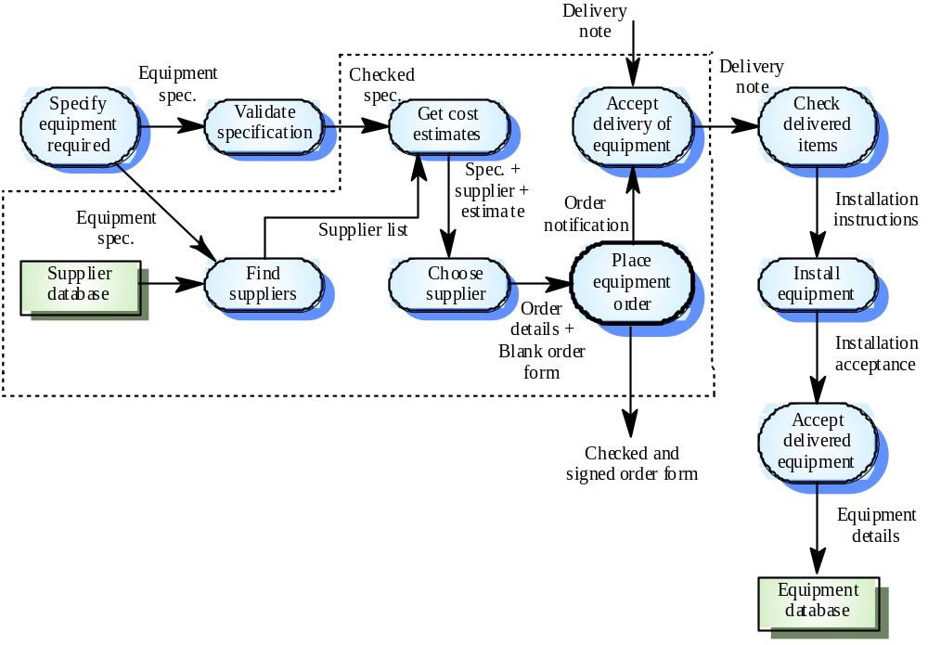
Equipment procurement process

Slide 196
Behavioural models
Behavioural models are used to describe the overall behaviour of a system
Two types of behavioural model are shown here
  Data processing models that show how data is processed as it moves through the system
  State machine models that show the systems response to events
Both of these models are required for a description of the system’s behaviour

Slide 197
Data-processing models
Data flow diagrams are used to model the system’s data processing
These show the processing steps as data flows through a system
Intrinsic part of many analysis methods
Simple and intuitive notation that customers can understand
Show end-to-end processing of data

Slide 198
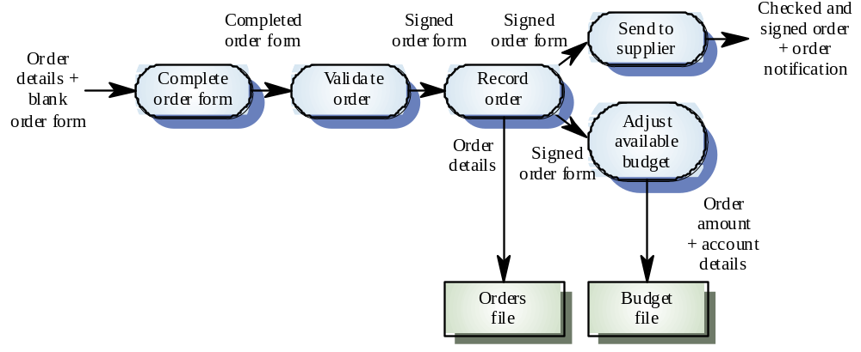
Order processing DFD

Slide 199
Data flow diagrams
DFDs model the system from a functional perspective
Tracking and documenting how the data associated with a process is helpful to develop an overall understanding of the system
Data flow diagrams may also be used in showing the data exchange between a system and other systems in its environment

Slide 200
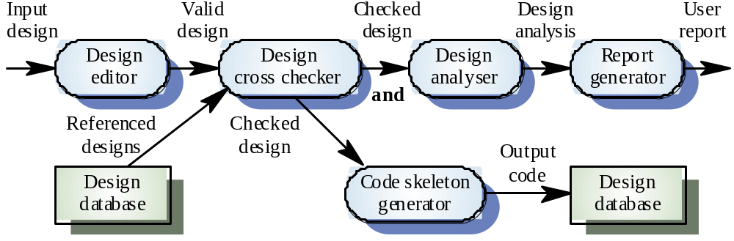
CASE toolset DFD

Slide 201
State machine models
These model the behaviour of the system in response to external and internal events
They show the system’s responses to stimuli so are often used for modelling real-time systems
State machine models show system states as nodes and events as arcs between these nodes. When an event occurs, the system moves from one state to another
Statecharts are an integral part of the UML

Slide 202
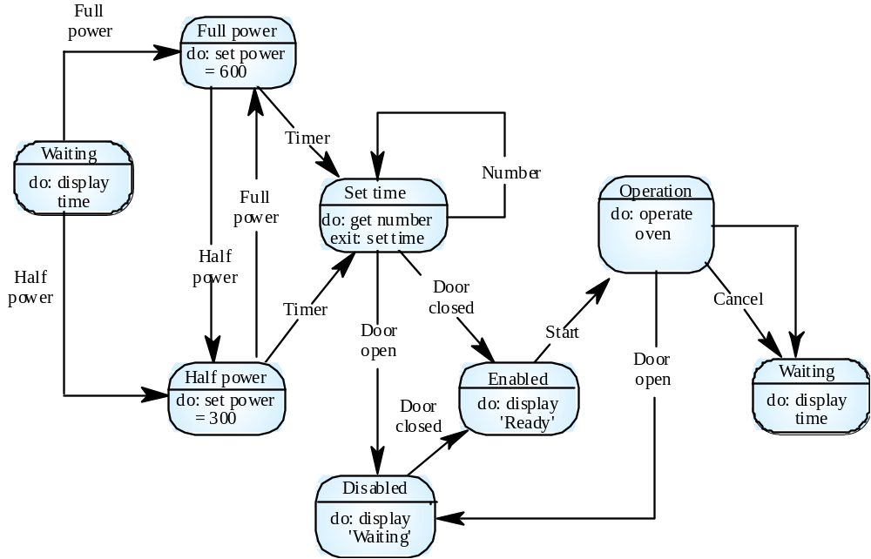
Microwave oven model

Slide 203
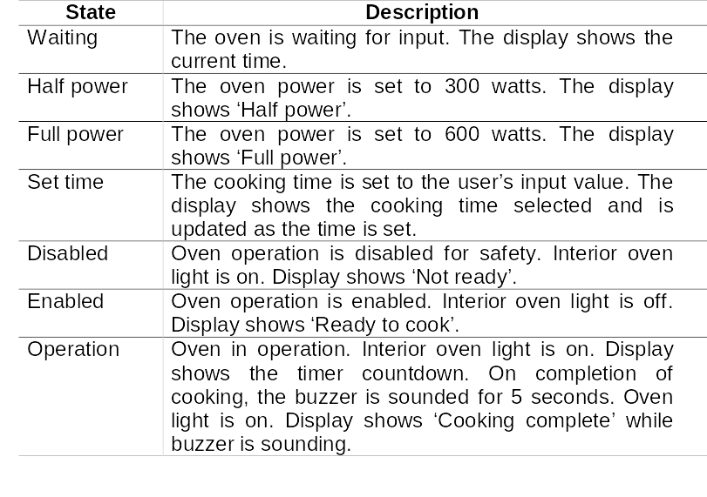
Microwave oven state description

Slide 204
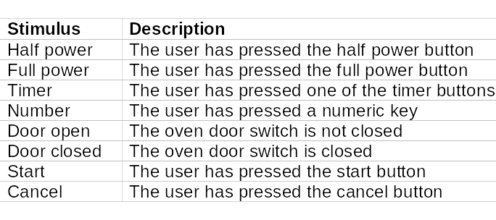
Microwave oven stimuli

Slide 205
Statecharts
Allow the decomposition of a model into sub-models (see following slide)
A brief description of the actions is included following the ‘do’ in each state
Can be complemented by tables describing the states and the stimuli

Slide 206
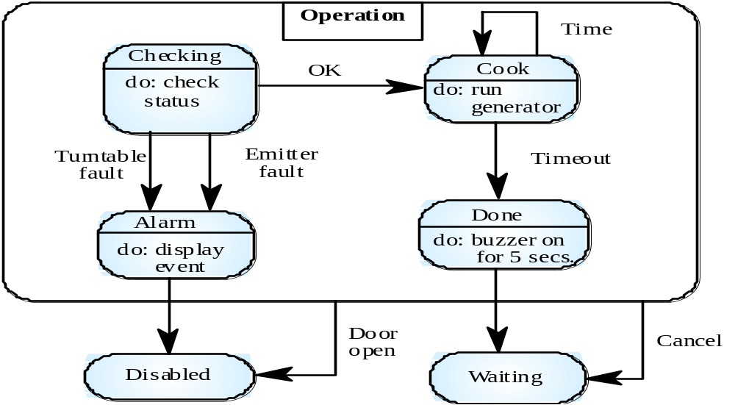
Microwave oven operation

Slide 207
Semantic data models
Used to describe the logical structure of data processed by the system
Entity-relation-attribute model sets out the entities in the system, the relationships between these entities and the entity attributes
Widely used in database design. Can readily be implemented using relational databases
No specific notation provided in the UML but objects and associations can be used

Slide 208
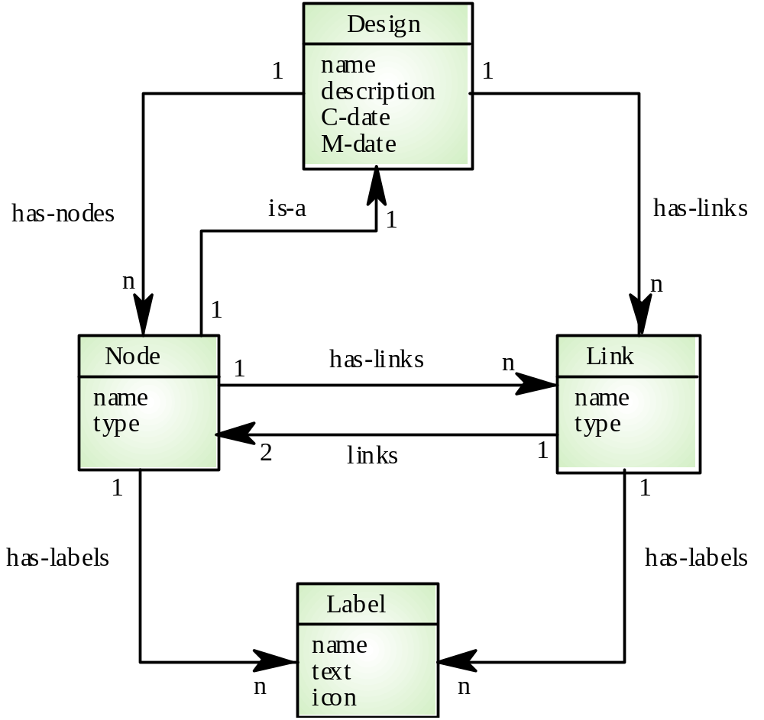
Software design semantic model

Slide 209
Data dictionaries
Data dictionaries are lists of all of the names used in the system models. Descriptions of the entities, relationships and attributes are also included
Advantages
  Support name management and avoid duplication
  Store of organisational knowledge linking analysis, design and implementation
Many CASE workbenches support data dictionaries

Slide 210
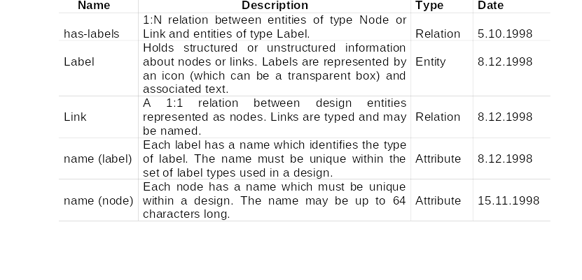
Data dictionary entries

Slide 211
Object models
Object models describe the system in terms of object classes
An object class is an abstraction over a set of objects with common attributes and the services (operations) provided by each object
Various object models may be produced
  Inheritance models
  Aggregation models
  Interaction models

Slide 212
Object models
Natural ways of reflecting the real-world entities manipulated by the system
More abstract entities are more difficult to model using this approach
Object class identification is recognised as a difficult process requiring a deep understanding of the application domain
Object classes reflecting domain entities are reusable across systems

Slide 213
Inheritance models
Organise the domain object classes into a hierarchy
Classes at the top of the hierarchy reflect the common features of all classes
Object classes inherit their attributes and services from one or more super-classes. these may then be specialised as necessary
Class hierarchy design is a difficult process if duplication in different branches is to be avoided

Slide 214
The Unified Modeling Language
Devised by the developers of widely used object-oriented analysis and design methods
Has become an effective standard for object-oriented modelling
Notation
  Object classes are rectangles with the name at the top, attributes in the middle section and operations in the bottom section
  Relationships between object classes (known as associations) are shown as lines linking objects
  Inheritance is referred to as generalisation and is shown ‘upwards’ rather than ‘downwards’ in a hierarchy

Slide 215
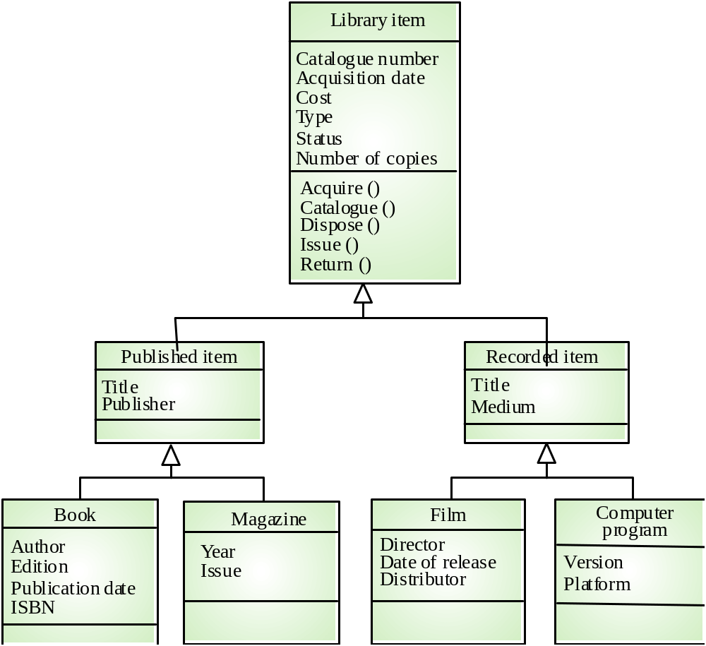
Library class hierarchy

Slide 216
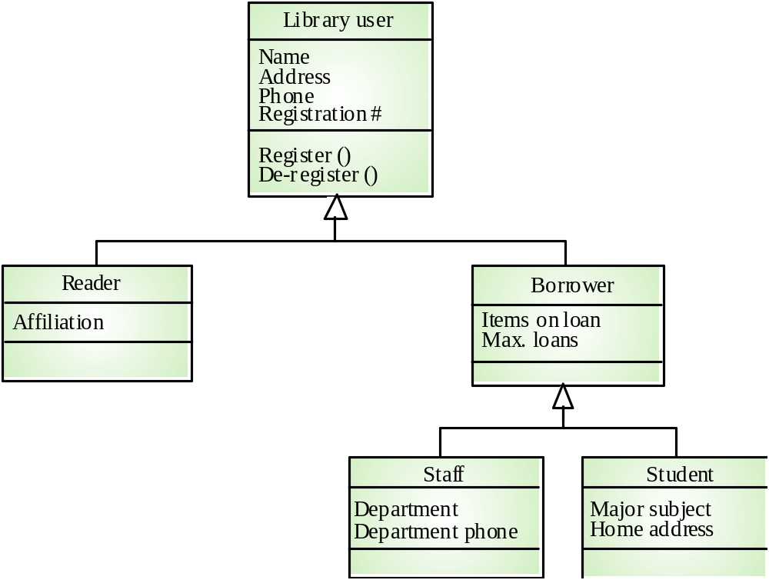
User class hierarchy

Slide 217
Multiple inheritance
Rather than inheriting the attributes and services from a single parent class, a system which supports multiple inheritance allows object classes to inherit from several super-classes
Can lead to semantic conflicts where attributes/services with the same name in different super-classes have different semantics
Makes class hierarchy reorganisation more complex

Slide 218
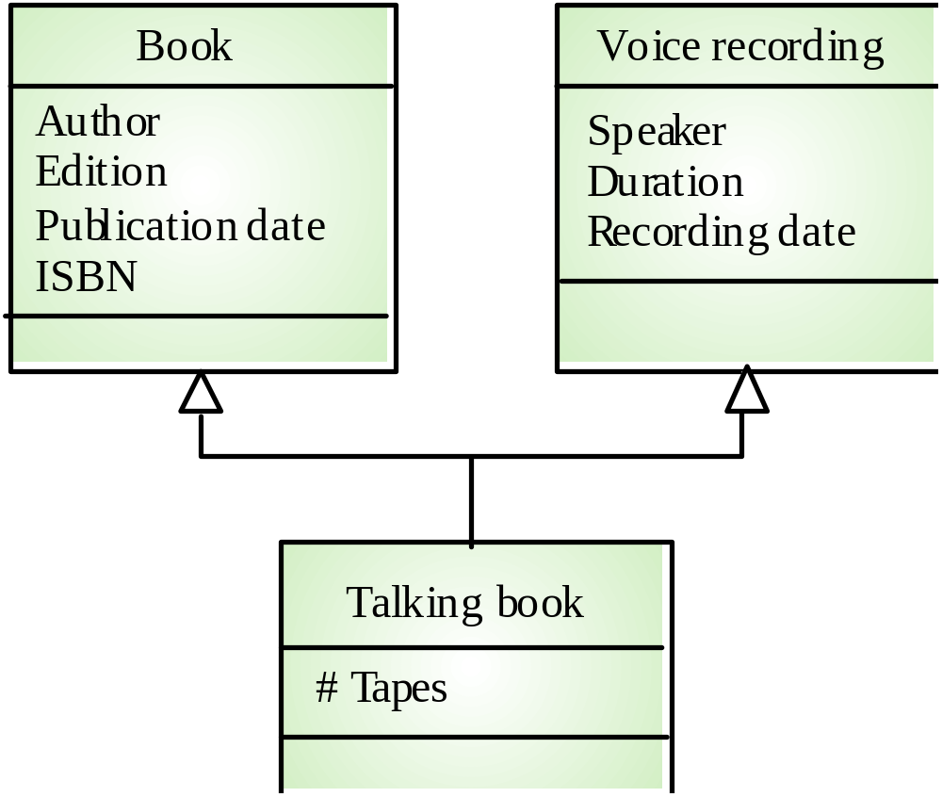
Multiple inheritance

Slide 219
Object aggregation
Aggregation model shows how classes which are collections are composed of other classes
Similar to the part-of relationship in semantic data models

Slide 220
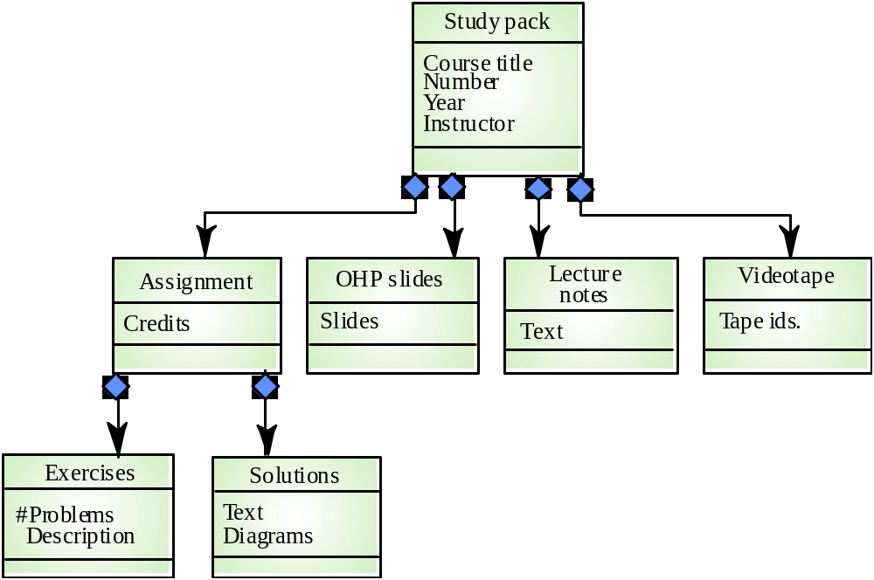
Object aggregation

Slide 221
Object behaviour modelling
A behavioural model shows the interactions between objects to produce some particular system behaviour that is specified as a use-case
Sequence diagrams (or collaboration diagrams) in the UML are used to model interaction between objects

Slide 222
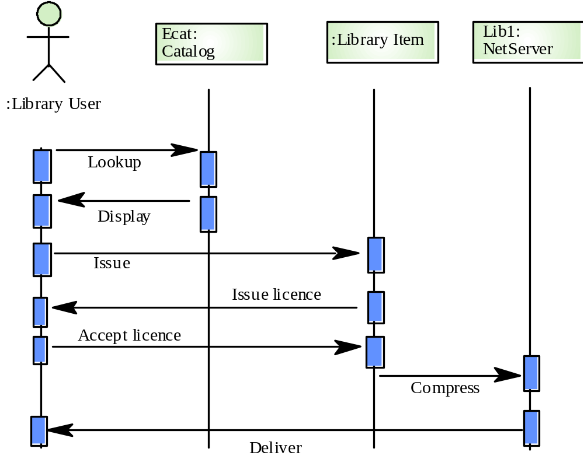
Issue of electronic items

Slide 223
CASE workbenches
A coherent set of tools that is designed to support related software process activities such as analysis, design or testing
Analysis and design workbenches support system modelling during both requirements engineering and system design
These workbenches may support a specific design method or may provide support for a creating several different types of system model

Slide 224

An analysis and design workbench

Slide 225
Analysis workbench components
Diagram editors
Model analysis and checking tools
Repository and associated query language
Data dictionary
Report definition and generation tools
Forms definition tools
Import/export translators
Code generation tools

Slide 226
Key points
A model is an abstract system view. Complementary types of model provide different system information
Context models show the position of a system in its environment with other systems and processes
Data flow models may be used to model the data processing in a system
State machine models model the system’s behaviour in response to internal or external events

Slide 227
Key points
Semantic data models describe the logical structure of data which is imported to or exported by the systems
Object models describe logical system entities, their classification and aggregation
Object models describe the logical system entities and their classification and aggregation
CASE workbenches support the development of system models

Slide 228
Software Prototyping

Slide 229
Software Prototyping
Rapid software development to validate requirements

Slide 230
Objectives
To describe the use of prototypes in different types of development project
To discuss evolutionary and throw-away prototyping
To introduce three rapid prototyping techniques - high-level language development, database programming and component reuse
To explain the need for user interface prototyping

Slide 231
Topics covered
Prototyping in the software process
Prototyping techniques
User interface prototyping

Slide 232
System prototyping
Prototyping is the rapid development of a system
In the past, the developed system was normally thought of as inferior in some way to the required system so further development was required
Now, the boundary between prototyping and normal system development is blurred and many systems are developed using an evolutionary approach

Slide 233
Uses of system prototypes
The principal use is to help customers and developers understand the requirements for the system
  Requirements elicitation. Users can experiment with a prototype to see how the system supports their work
  Requirements validation. The prototype can reveal errors and omissions in the requirements
Prototyping can be considered as a risk reduction activity which reduces requirements risks

Slide 234
Prototyping benefits
Misunderstandings between software users and developers are exposed
Missing services may be detected and confusing services may be identified
A working system is available early in the process
The prototype may serve as a basis for deriving a system specification
The system can support user training and system testing

Slide 235

Prototyping process

Slide 236
Prototyping benefits
Improved system usability
Closer match to the system needed
Improved design quality
Improved maintainability
Reduced overall development effort

Slide 237
Prototyping in the software process
Evolutionary prototyping
  An approach to system development where an initial prototype is produced and refined through a number of stages to the final system
Throw-away prototyping
  A prototype which is usually a practical implementation of the system is produced to help discover requirements problems and then discarded. The system is then developed using some other development process

Slide 238
Prototyping objectives
The objective of evolutionary prototyping is to deliver a working system to end-users. The development starts with those requirements which are best understood.
The objective of throw-away prototyping is to validate or derive the system requirements. The prototyping process starts with those requirements which are poorly understood

Slide 239

Approaches to prototyping

Slide 240
Evolutionary prototyping
Must be used for systems where the specification cannot be developed in advance e.g. AI systems and user interface systems
Based on techniques which allow rapid system iterations
Verification is impossible as there is no specification. Validation means demonstrating the adequacy of the system

Slide 241

Evolutionary prototyping

Slide 242
Evolutionary prototyping advantages
Accelerated delivery of the system
  Rapid delivery and deployment are sometimes more important than functionality or long-term software maintainability
User engagement with the system
  Not only is the system more likely to meet user requirements, they are more likely to commit to the use of the system

Slide 243
Evolutionary prototyping
Specification, design and implementation are inter-twined
The system is developed as a series of increments that are delivered to the customer
Techniques for rapid system development are used such as CASE tools and 4GLs
User interfaces are usually developed using a GUI development toolkit

Slide 244
Evolutionary prototyping problems
Management problems
  Existing management processes assume a waterfall model of development
  Specialist skills are required which may not be available in all development teams
Maintenance problems
  Continual change tends to corrupt system structure so long-term maintenance is expensive

Slide 245
Prototypes as specifications
Some parts of the requirements (e.g. safety-critical functions) may be impossible to prototype and so don’t appear in the specification
An implementation has no legal standing as a contract
Non-functional requirements cannot be adequately tested in a system prototype

Slide 246
Incremental development
System is developed and delivered in increments after establishing an overall architecture
Requirements and specifications for each increment may be developed
Users may experiment with delivered increments while others are being developed. therefore, these serve as a form of prototype system
Intended to combine some of the advantages of prototyping but with a more manageable process and better system structure

Slide 247

Incremental development process

Slide 248
Throw-away prototyping
Used to reduce requirements risk
The prototype is developed from an initial specification, delivered for experiment then discarded
The throw-away prototype should NOT be considered as a final system
  Some system characteristics may have been left out
  There is no specification for long-term maintenance
  The system will be poorly structured and difficult to maintain

Slide 249

Throw-away prototyping

Slide 250
Prototype delivery
Developers may be pressurised to deliver a throw-away prototype as a final system
This is not recommended
  It may be impossible to tune the prototype to meet non-functional requirements
  The prototype is inevitably undocumented
  The system structure will be degraded through changes made during development
  Normal organisational quality standards may not have been applied

Slide 251
Rapid prototyping techniques
Various techniques may be used for rapid development
  Dynamic high-level language development
  Database programming
  Component and application assembly
These are not exclusive techniques - they are often used together
Visual programming is an inherent part of most prototype development systems

Slide 252
Dynamic high-level languages
Languages which include powerful data management facilities
Need a large run-time support system. Not normally used for large system development
Some languages offer excellent UI development facilities
Some languages have an integrated support environment whose facilities may be used in the prototype

Slide 253
Choice of prototyping language
What is the application domain of the problem?
What user interaction is required?
What support environment comes with the language?
Different parts of the system may be programmed in different languages. However, there may be problems with language communications

Slide 254
Database programming languages
Domain specific languages for business systems based around a database management system
Normally include a database query language, a screen generator, a report generator and a spreadsheet.
May be integrated with a CASE toolset
The language + environment is sometimes known as a fourth-generation language (4GL)
Cost-effective for small to medium sized business systems

Slide 255

Database programming

Slide 256
Component and application assembly
Prototypes can be created quickly from a set of reusable components plus some mechanism to ‘glue’ these component together
The composition mechanism must include control facilities and a mechanism for component communication
The system specification must take into account the availability and functionality of existing components

Slide 257
Prototyping with reuse
Application level development
  Entire application systems are integrated with the prototype so that their functionality can be shared
  For example, if text preparation is required, a standard word processor can be used
Component level development
  Individual components are integrated within a standard framework to implement the system
  Frame work can be a scripting language or an integration framework such as CORBA

Slide 258

Reusable component composition

Slide 259
Compound documents
For some applications, a prototype can be created by developing a compound document
This is a document with active elements (such as a spreadsheet) that allow user computations
Each active element has an associated application which is invoked when that element is selected
The document itself is the integrator for the different applications

Slide 260

Application linking in compound documents

Slide 261
Visual programming
Scripting languages such as Visual Basic support visual programming where the prototype is developed by creating a user interface from standard items and associating components with these items
A large library of components exists to support this type of development
These may be tailored to suit the specific application requirements

Slide 262

Visual programming with reuse

Slide 263
Problems with visual development
Difficult to coordinate team-based development
No explicit system architecture
Complex dependencies between parts of the program can cause maintainability problems

Slide 264
User interface prototyping
It is impossible to pre-specify the look and feel of a user interface in an effective way. prototyping is essential
UI development consumes an increasing part of overall system development costs
User interface generators may be used to ‘draw’ the interface and simulate its functionality with components associated with interface entities
Web interfaces may be prototyped using a web site editor

Slide 265
Key points
A prototype can be used to give end-users a concrete impression of the system’s capabilities
Prototyping is becoming increasingly used for system development where rapid development is essential
Throw-away prototyping is used to understand the system requirements
In evolutionary prototyping, the system is developed by evolving an initial version to the final version

Slide 266
Key points
Rapid development of prototypes is essential. This may require leaving out functionality or relaxing non-functional constraints
Prototyping techniques include the use of very high-level languages, database programming and prototype construction from reusable components
Prototyping is essential for parts of the system such as the user interface which cannot be effectively pre-specified. Users must be involved in prototype evaluation

Slide 267
Architectural Design

Slide 268
Architectural Design
Establishing the overall structure of a software system

Slide 269
Objectives
To introduce architectural design and to discuss its importance
To explain why multiple models are required to document a software architecture
To describe types of architectural model that may be used
To discuss how domain-specific reference models may be used as a basis for product-lines and to compare software architectures

Slide 270
Topics covered
System structuring
Control models
Modular decomposition
Domain-specific architectures

Slide 271
Software architecture
The design process for identifying the sub-systems making up a system and the framework for sub-system control and communication is architectural design
The output of this design process is a description of the software architecture

Slide 272
Architectural design
An early stage of the system design process
Represents the link between specification and design processes
Often carried out in parallel with some specification activities
It involves identifying major system components and their communications

Slide 273
Advantages of explicit architecture
Stakeholder communication
  Architecture may be used as a focus of discussion by system stakeholders
System analysis
  Means that analysis of whether the system can meet its non-functional requirements is possible
Large-scale reuse
  The architecture may be reusable across a range of systems

Slide 274
Architectural design process
System structuring
  The system is decomposed into several principal sub-systems and communications between these sub-systems are identified
Control modelling
  A model of the control relationships between the different parts of the system is established
Modular decomposition
  The identified sub-systems are decomposed into modules

Slide 275
Sub-systems and modules
A sub-system is a system in its own right whose operation is independent of the services provided by other sub-systems.
A module is a system component that provides services to other components but would not normally be considered as a separate system

Slide 276
Architectural models
Different architectural models may be produced during the design process
Each model presents different perspectives on the architecture

Slide 277
Architectural models
Static structural model that shows the major system components
Dynamic process model that shows the process structure of the system
Interface model that defines sub-system interfaces
Relationships model such as a data-flow model

Slide 278
Architectural styles
The architectural model of a system may conform to a generic architectural model or style
An awareness of these styles can simplify the problem of defining system architectures
However, most large systems are heterogeneous and do not follow a single architectural style

Slide 279
Architecture attributes
Performance
  Localise operations to minimise sub-system communication
Security
  Use a layered architecture with critical assets in inner layers
Safety
  Isolate safety-critical components
Availability
  Include redundant components in the architecture
Maintainability
  Use fine-grain, self-contained components

Slide 280
System structuring
Concerned with decomposing the system into interacting sub-systems
The architectural design is normally expressed as a block diagram presenting an overview of the system structure
More specific models showing how sub-systems share data, are distributed and interface with each other may also be developed

Slide 281

Packing robot control system

Slide 282
The repository model
Sub-systems must exchange data. This may be done in two ways:
  Shared data is held in a central database or repository and may be accessed by all sub-systems
  Each sub-system maintains its own database and passes data explicitly to other sub-systems
When large amounts of data are to be shared, the repository model of sharing is most commonly used

Slide 283

CASE toolset architecture

Slide 284
Repository model characteristics
Advantages
  Efficient way to share large amounts of data
  Sub-systems need not be concerned with how data is produced Centralised management e.g. backup, security, etc.
  Sharing model is published as the repository schema
Disadvantages
  Sub-systems must agree on a repository data model. Inevitably a compromise
  Data evolution is difficult and expensive
  No scope for specific management policies
  Difficult to distribute efficiently

Slide 285
Client-server architecture
Distributed system model which shows how data and processing is distributed across a range of components
Set of stand-alone servers which provide specific services such as printing, data management, etc.
Set of clients which call on these services
Network which allows clients to access servers

Slide 286

Film and picture library

Slide 287
Client-server characteristics
Advantages
  Distribution of data is straightforward
  Makes effective use of networked systems. May require cheaper hardware
  Easy to add new servers or upgrade existing servers
Disadvantages
  No shared data model so sub-systems use different data organisation. data interchange may be inefficient
  Redundant management in each server
  No central register of names and services - it may be hard to find out what servers and services are available

Slide 288
Abstract machine model
Used to model the interfacing of sub-systems
Organises the system into a set of layers (or abstract machines) each of which provide a set of services
Supports the incremental development of sub-systems in different layers. When a layer interface changes, only the adjacent layer is affected
However, often difficult to structure systems in this way

Slide 289

Version management system

Slide 290
Control models
Are concerned with the control flow between sub-systems. Distinct from the system decomposition model
Centralised control
  One sub-system has overall responsibility for control and starts and stops other sub-systems
Event-based control
  Each sub-system can respond to externally generated events from other sub-systems or the system’s environment

Slide 291
Centralised control
A control sub-system takes responsibility for managing the execution of other sub-systems
Call-return model
  Top-down subroutine model where control starts at the top of a subroutine hierarchy and moves downwards. Applicable to sequential systems
Manager model
  Applicable to concurrent systems. One system component controls the stopping, starting and coordination of other system processes. Can be implemented in sequential systems as a case statement

Slide 292

Call-return model

Slide 293

Real-time system control

Slide 294
Event-driven systems
Driven by externally generated events where the timing of the event is outwith the control of the sub-systems which process the event
Two principal event-driven models
  Broadcast models. An event is broadcast to all sub-systems. Any sub-system which can handle the event may do so
  Interrupt-driven models. Used in real-time systems where interrupts are detected by an interrupt handler and passed to some other component for processing
Other event driven models include spreadsheets and production systems

Slide 295
Broadcast model
Effective in integrating sub-systems on different computers in a network
Sub-systems register an interest in specific events. When these occur, control is transferred to the sub-system which can handle the event
Control policy is not embedded in the event and message handler. Sub-systems decide on events of interest to them
However, sub-systems don’t know if or when an event will be handled

Slide 296

Selective broadcasting

Slide 297
Interrupt-driven systems
Used in real-time systems where fast response to an event is essential
There are known interrupt types with a handler defined for each type
Each type is associated with a memory location and a hardware switch causes transfer to its handler
Allows fast response but complex to program and difficult to validate

Slide 298

Interrupt-driven control

Slide 299
Modular decomposition
Another structural level where sub-systems are decomposed into modules
Two modular decomposition models covered
  An object model where the system is decomposed into interacting objects
  A data-flow model where the system is decomposed into functional modules which transform inputs to outputs. Also known as the pipeline model
If possible, decisions about concurrency should be delayed until modules are implemented

Slide 300
Object models
Structure the system into a set of loosely coupled objects with well-defined interfaces
Object-oriented decomposition is concerned with identifying object classes, their attributes and operations
When implemented, objects are created from these classes and some control model used to coordinate object operations

Slide 301

Invoice processing system

Slide 302
Data-flow models
Functional transformations process their inputs to produce outputs
May be referred to as a pipe and filter model (as in UNIX shell)
Variants of this approach are very common. When transformations are sequential, this is a batch sequential model which is extensively used in data processing systems
Not really suitable for interactive systems

Slide 303

Invoice processing system

Slide 304
Domain-specific architectures
Architectural models which are specific to some application domain
Two types of domain-specific model
  Generic models which are abstractions from a number of real systems and which encapsulate the principal characteristics of these systems
  Reference models which are more abstract, idealised model. Provide a means of information about that class of system and of comparing different architectures
Generic models are usually bottom-up models; Reference models are top-down models

Slide 305
Generic models
Compiler model is a well-known example although other models exist in more specialised application domains
  Lexical analyser
  Symbol table
  Syntax analyser
  Syntax tree
  Semantic analyser
  Code generator
Generic compiler model may be organised according to different architectural models

Slide 306

Compiler model

Slide 307

Language processing system

Slide 308
Reference architectures
Reference models are derived from a study of the application domain rather than from existing systems
May be used as a basis for system implementation or to compare different systems. It acts as a standard against which systems can be evaluated
OSI model is a layered model for communication systems

Slide 309

OSI reference model
Application

Slide 310
Key points
The software architect is responsible for deriving a structural system model, a control model and a sub-system decomposition model
Large systems rarely conform to a single architectural model
System decomposition models include repository models, client-server models and abstract machine models
Control models include centralised control and event-driven models

Slide 311
Key points
Modular decomposition models include data-flow and object models
Domain specific architectural models are abstractions over an application domain. They may be constructed by abstracting from existing systems or may be idealised reference models

Slide 312
Distributed Systems Architectures

Slide 313
Distributed Systems Architectures
Architectural design for software that executes on more than one processor

Slide 314
Objectives
To explain the advantages and disadvantages of distributed systems architectures
To describe different approaches to the development of client-server systems
To explain the differences between client-server and distributed object architectures
To describe object request brokers and the principles underlying the CORBA standards

Slide 315
Topics covered
Multiprocessor architectures
Client-server architectures
Distributed object architectures
CORBA

Slide 316
Distributed systems
Virtually all large computer-based systems are now distributed systems
Information processing is distributed over several computers rather than confined to a single machine
Distributed software engineering is now very important

Slide 317
System types
Personal systems that are not distributed and that are designed to run on a personal computer or workstation.
Embedded systems that run on a single processor or on an integrated group of processors.
Distributed systems where the system software runs on a loosely integrated group of cooperating processors linked by a network.

Slide 318
Distributed system characteristics
Resource sharing
Openness
Concurrency
Scalability
Fault tolerance
Transparency

Slide 319
Distributed system disadvantages
Complexity
Security
Manageability
Unpredictability

Slide 320

Issues in distributed system design

Slide 321
Distributed systems archiectures
Client-server architectures
  Distributed services which are called on by clients. Servers that provide services are treated differently from clients that use services
Distributed object architectures
  No distinction between clients and servers. Any object on the system may provide and use services from other objects

Slide 322
Middleware
Software that manages and supports the different components of a distributed system. In essence, it sits in the middle of the system
Middleware is usually off-the-shelf rather than specially written software
Examples
  Transaction processing monitors
  Data convertors
  Communication controllers

Slide 323
Multiprocessor architectures
Simplest distributed system model
System composed of multiple processes which may (but need not) execute on different processors
Architectural model of many large real-time systems
Distribution of process to processor may be pre-ordered or may be under the control of a despatcher

Slide 324

A multiprocessor traffic control system

Slide 325
Client-server architectures
The application is modelled as a set of services that are provided by servers and a set of clients that use these services
Clients know of servers but servers need not know of clients
Clients and servers are logical processes
The mapping of processors to processes is not necessarily 1 : 1

Slide 326

A client-server system

Slide 327

Computers in a C/S network

Slide 328
Layered application architecture
Presentation layer
  Concerned with presenting the results of a computation to system users and with collecting user inputs
Application processing layer
  Concerned with providing application specific functionality e.g., in a banking system, banking functions such as open account, close account, etc.
Data management layer
  Concerned with managing the system databases

Slide 329

Application layers

Slide 330
Thin and fat clients
Thin-client model
  In a thin-client model, all of the application processing and data management is carried out on the server. The client is simply responsible for running the presentation software.
Fat-client model
  In this model, the server is only responsible for data management. The software on the client implements the application logic and the interactions with the system user.

Slide 331

Thin and fat clients

Slide 332
Thin client model
Used when legacy systems are migrated to client server architectures.
  The legacy system acts as a server in its own right with a graphical interface implemented on a client
A major disadvantage is that it places a heavy processing load on both the server and the network

Slide 333
Fat client model
More processing is delegated to the client as the application processing is locally executed
Most suitable for new C/S systems where the capabilities of the client system are known in advance
More complex than a thin client model especially for management. New versions of the application have to be installed on all clients

Slide 334

A client-server ATM system

Slide 335
Three-tier architectures
In a three-tier architecture, each of the application architecture layers may execute on a separate processor
Allows for better performance than a thin-client approach and is simpler to manage than a fat-client approach
A more scalable architecture - as demands increase, extra servers can be added

Slide 336

A 3-tier C/S architecture

Slide 337

An internet banking system

Slide 338

Use of C/S architectures

Slide 339
Distributed object architectures
There is no distinction in a distributed object architectures between clients and servers
Each distributable entity is an object that provides services to other objects and receives services from other objects
Object communication is through a middleware system called an object request broker (software bus)
However, more complex to design than C/S systems

Slide 340

Distributed object architecture

Slide 341
Advantages of distributed object architecture
It allows the system designer to delay decisions on where and how services should be provided
It is a very open system architecture that allows new resources to be added to it as required
The system is flexible and scaleable
It is possible to reconfigure the system dynamically with objects migrating across the network as required

Slide 342
Uses of distributed object architecture
As a logical model that allows you to structure and organise the system. In this case, you think about how to provide application functionality solely in terms of services and combinations of services
As a flexible approach to the implementation of client-server systems. The logical model of the system is a client-server model but both clients and servers are realised as distributed objects communicating through a software bus

Slide 343

A data mining system

Slide 344
Data mining system
The logical model of the system is not one of service provision where there are distinguished data management services
It allows the number of databases that are accessed to be increased without disrupting the system
It allows new types of relationship to be mined by adding new integrator objects

Slide 345
CORBA
CORBA is an international standard for an Object Request Broker - middleware to manage communications between distributed objects
Several implementation of CORBA are available
DCOM is an alternative approach by Microsoft to object request brokers
CORBA has been defined by the Object Management Group

Slide 346
Application structure
Application objects
Standard objects, defined by the OMG, for a specific domain e.g. insurance
Fundamental CORBA services such as directories and security management
Horizontal (i.e. cutting across applications) facilities such as user interface facilities

Slide 347

CORBA application structure

Slide 348
CORBA standards
An object model for application objects
  A CORBA object is an encapsulation of state with a well-defined, language-neutral interface defined in an IDL (interface definition language)
An object request broker that manages requests for object services
A set of general object services of use to many distributed applications
A set of common components built on top of these services

Slide 349
CORBA objects
CORBA objects are comparable, in principle, to objects in C++ and Java
They MUST have a separate interface definition that is expressed using a common language (IDL) similar to C++
There is a mapping from this IDL to programming languages (C++, Java, etc.)
Therefore, objects written in different languages can communicate with each other

Slide 350
Object request broker (ORB)
The ORB handles object communications. It knows of all objects in the system and their interfaces
Using an ORB, the calling object binds an IDL stub that defines the interface of the called object
Calling this stub results in calls to the ORB which then calls the required object through a published IDL skeleton that links the interface to the service implementation

Slide 351

ORB-based object communications

Slide 352
Inter-ORB communications
ORBs are not usually separate programs but are a set of objects in a library that are linked with an application when it is developed
ORBs handle communications between objects executing on the sane machine
Several ORBS may be available and each computer in a distributed system will have its own ORB
Inter-ORB communications are used for distributed object calls

Slide 353

Inter-ORB communications

Slide 354
CORBA services
Naming and trading services
  These allow objects to discover and refer to other objects on the network
Notification services
  These allow objects to notify other objects that an event has occurred
Transaction services
  These support atomic transactions and rollback on failure

Slide 355
Key points
Almost all new large systems are distributed systems
Distributed systems support resource sharing, openness, concurrency, scalability, fault tolerance and transparency
Client-server architectures involve services being delivered by servers to programs operating on clients
User interface software always runs on the client and data management on the server

Slide 356
Key points
In a distributed object architecture, there is no distinction between clients and servers
Distributed object systems require middleware to handle object communications
The CORBA standards are a set of middleware standards that support distributed object architectures

